Slide 1
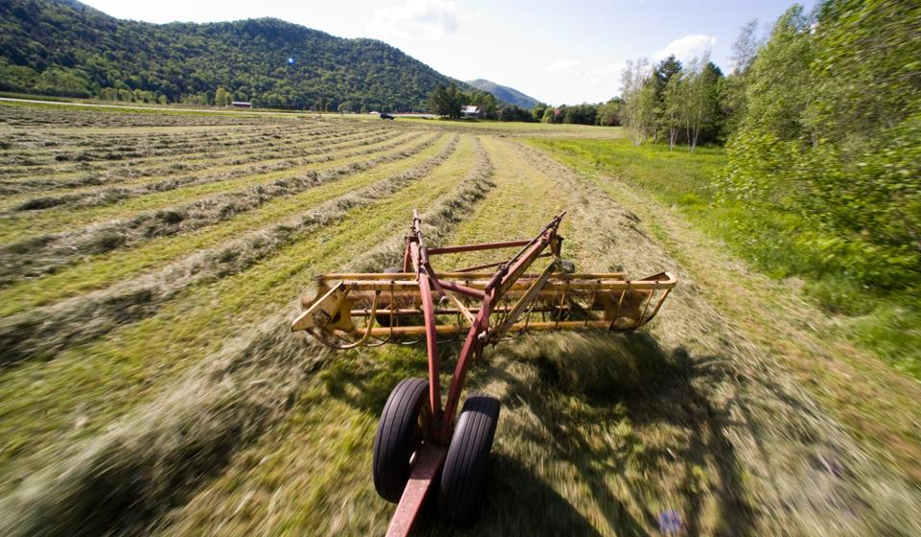
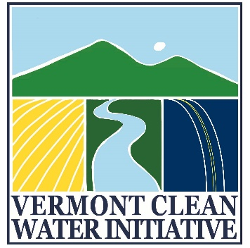

Act 64 Implementation:
Required Agricultural Practices (RAPs)

Slide 2
What are the RAPs?
Act 64
RAPs
VAAFM was directed by the Legislature to draft the RAPs pursuant to Act 64, signed into law on June 16, 2015.
VAAFM was charged with filing a Final Proposed Rule on or before September 15, 2016
Rule became effective December 5, 2016
AAPs Since 1995
Act 64 requires that the revised RAPs include requirements for:
  small farm certification,
  nutrient storage,
  soil health,
  buffer zones,
  livestock exclusion, and
  nutrient management.
  Tile Drainage Rules for Jan 15, 2018
Notes:
VAAFM was directed by the Legislature to draft the RAPs pursuant to Act 64, signed into law on June 16, 2015. Act 64 amended and enacted multiple requirements related to water quality in the State. The “Accepted Agricultural Practices (AAPs)” were rewritten to a higher level of performance and renamed the “Required Agricultural Practices (RAPs).” VAAFM was charged with revising the RAPs by rule on or before July 1, 2016. Act 64 requires that the revised RAPs include requirements for: small farm certification, nutrient storage, soil health, buffer zones, livestock exclusion, and nutrient management.
All Small Farm Operations (SFOs) in Vermont have been required to adhere to the Accepted Agricultural Practices (AAPs) since their establishment in 1995, though no certification or permit process existed to ensure farm compliance. Due to staffing limitations, the VAAFM has been able to inspect SFOs only on a complaint-driven system.
As part of Act 64, the Vermont Clean Water Act passed June 2015, the Agency is in the process of creating a certification program for Small Farm Operations (SFOs). The goal of this program is to oversee water quality issues on operations not currently inspected by the Agency of Agriculture. All small farms that fall under the new small farm definition will be required to participate in a Vermont-specific certification and training program This certification program will ensure that all SFOs are complying with the updated Required Agricultural Practices (RAPs), which are currently being revised from the Accepted Agricultural Practices (AAPs). The SFO Program has been created to meet the requirements of the EPA’s updated TMDL for Lake Champlain, and aims to reduce the amount of phosphorus and other pollutants entering Vermont waterways.

Slide 3
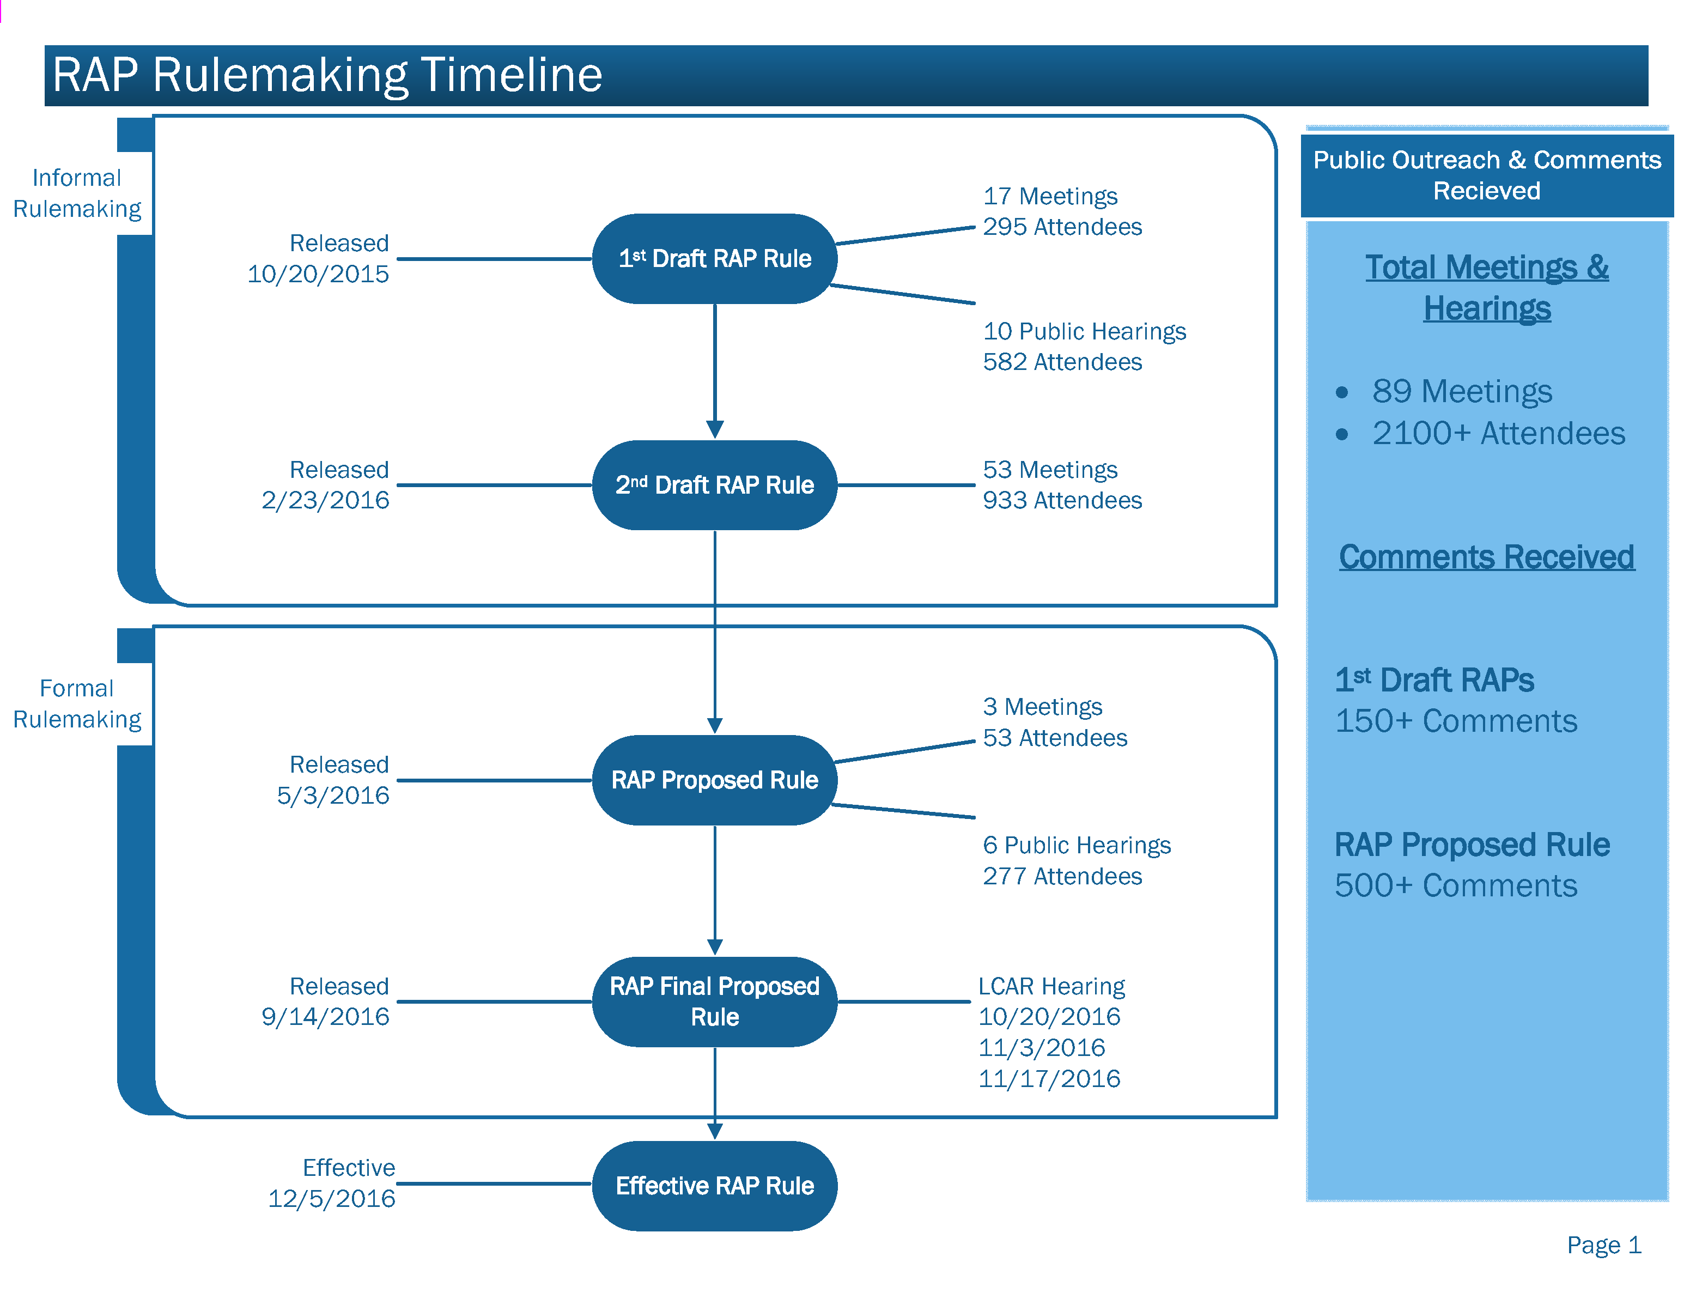

Slide 4

Vermont Clean Water Initiative:
All-In
WWTF
Forest Lands
Developed Lands Including Paved Roads
Unpaved Roads
River Corridors & Floodplains
Wetlands
Ag Lands
Notes:
All-In
Time, Flexibility, Support

Slide 5
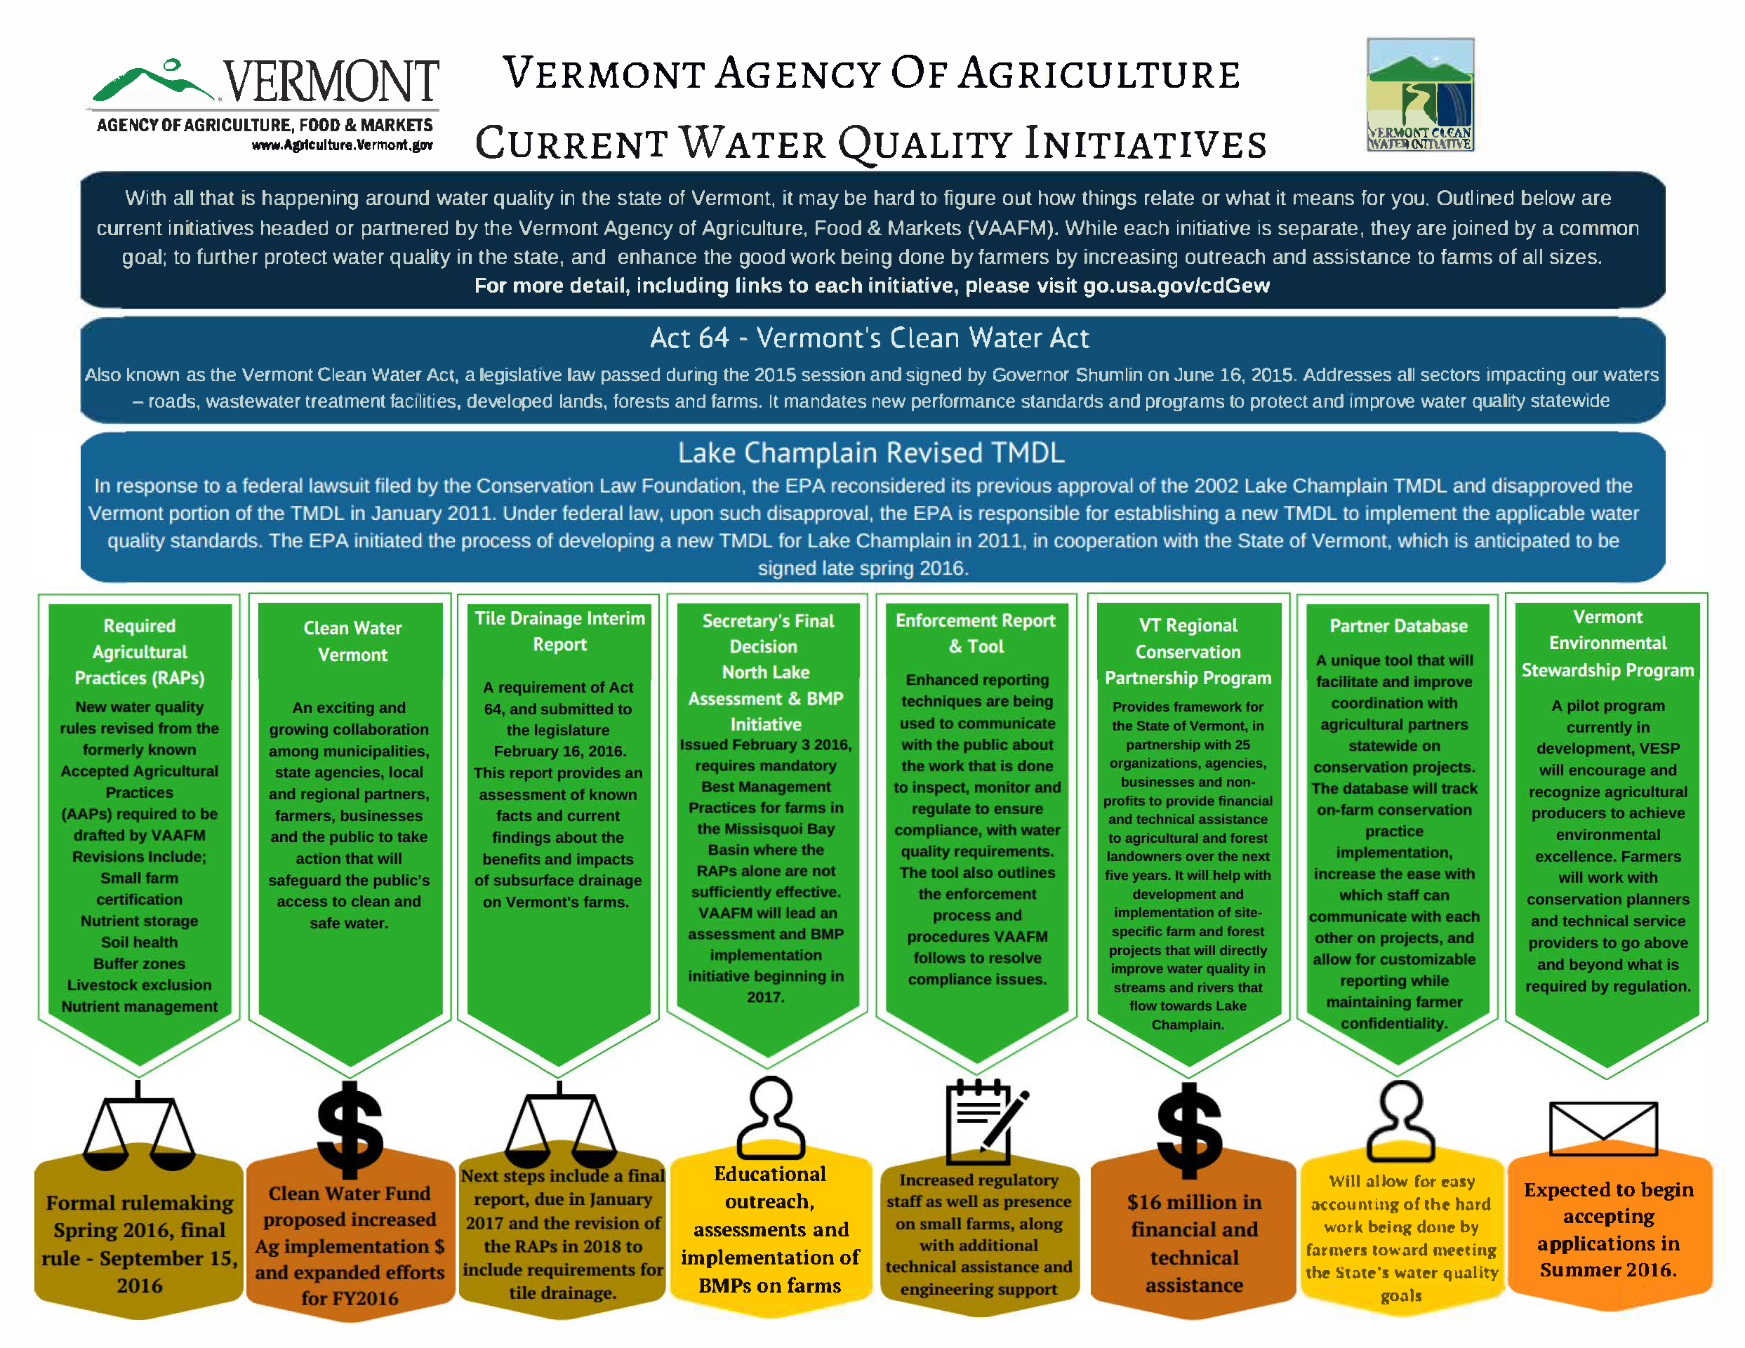

Slide 6

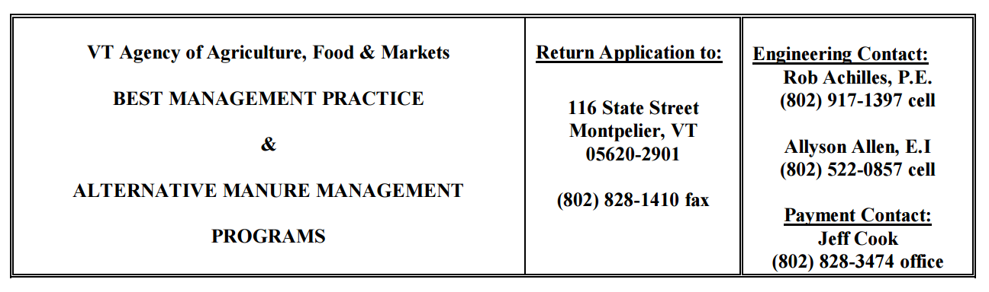
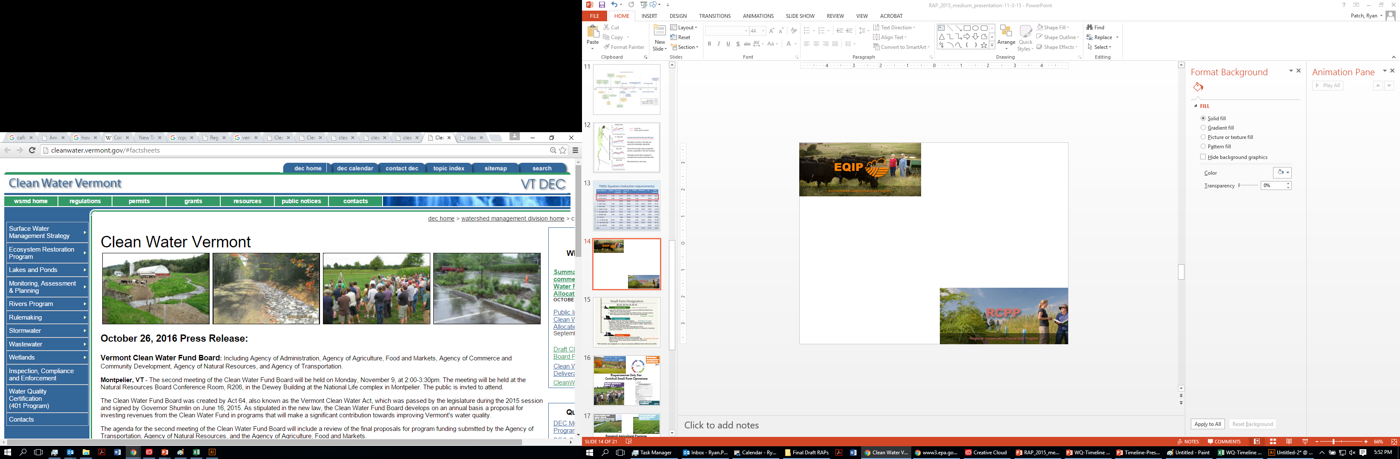

USDA NRCS: $45 million over 5 years
Technical and Financial Assistance Available for all Farms in Vermont
Vermont Clean Water Fund:
$1.75 Million Proposed for Farms
State of Vermont RCPP: $16 million
Long Island Sound RCPP: $10 million
VACD RCPP: $800,000
Memphremagog RCPP: $600K

Slide 7
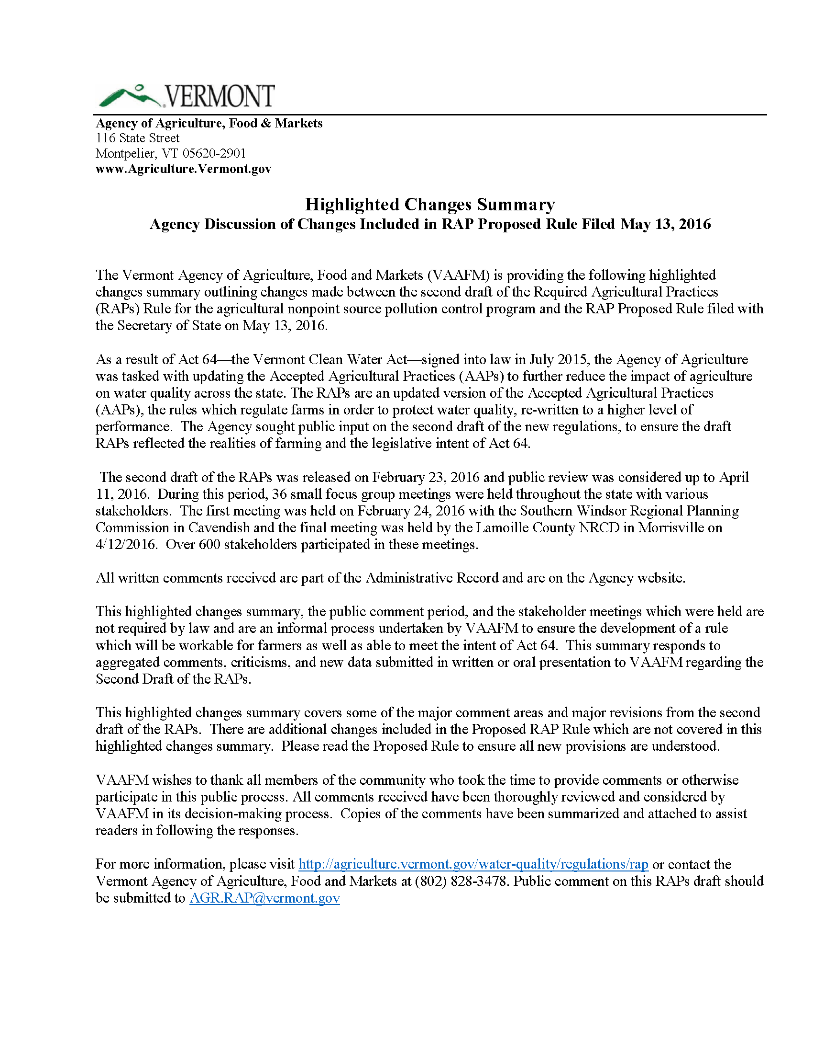
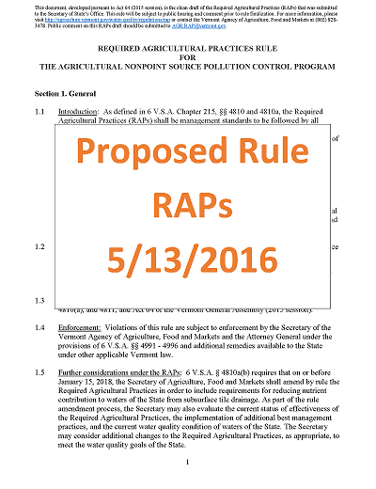
agriculture.vermont.gov/rap
RAP Final Rule
Effective: 12/6/2016

Slide 8
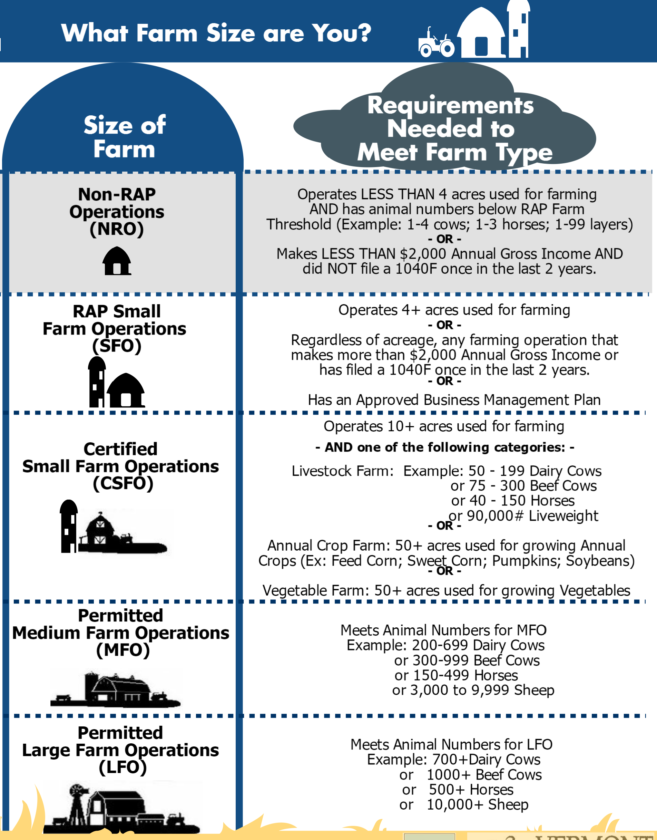
Estimated
# Farms
6000
700
140
27

Slide 9
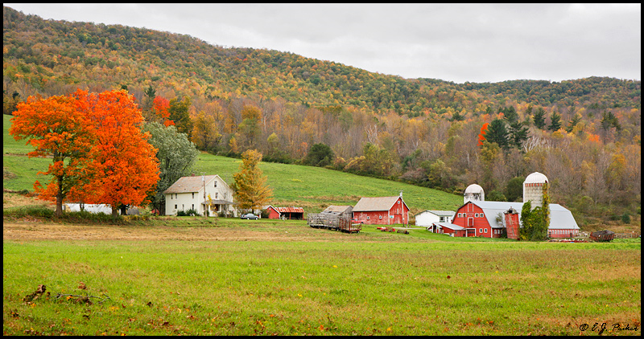
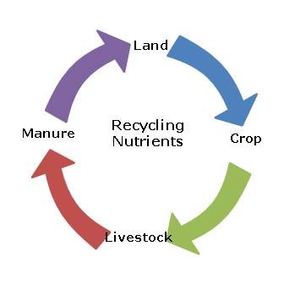
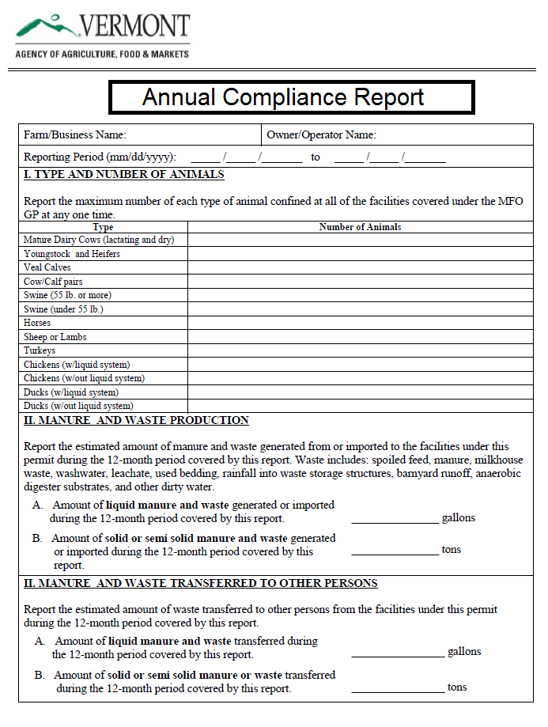
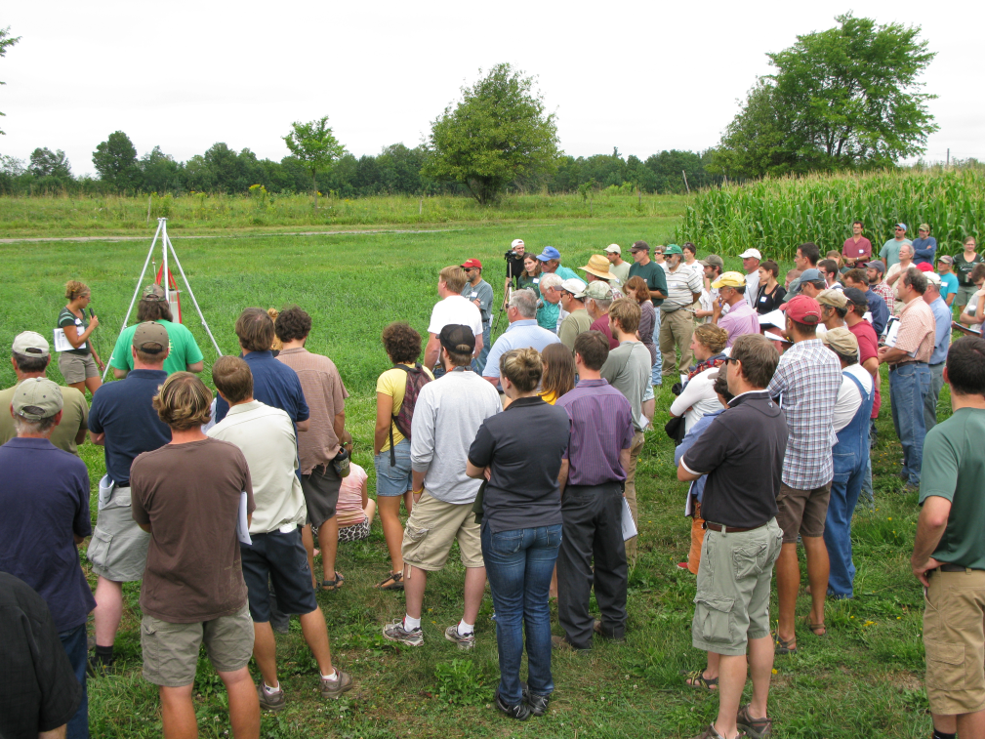
Minimum inspection within 7 years
590 Nutrient management plan required
Requirements Only For:
Certified Small Farm Operations
Required education for farmers
Annually Report Compliance

Slide 10
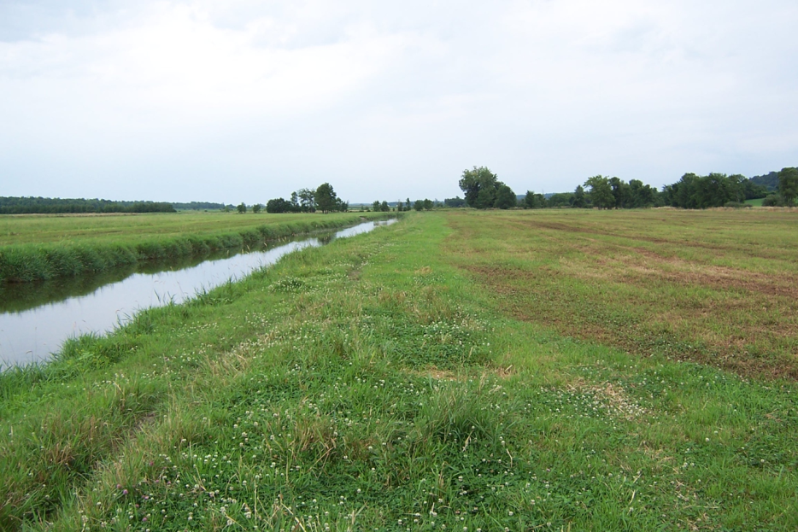
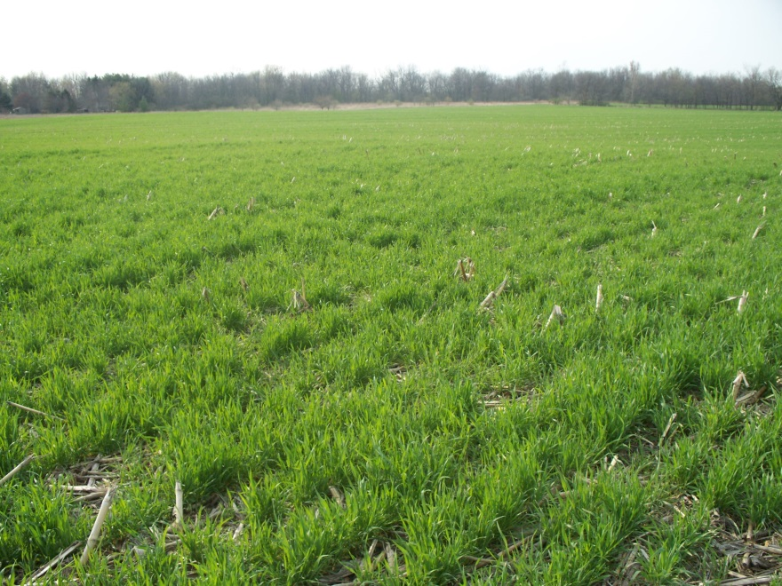
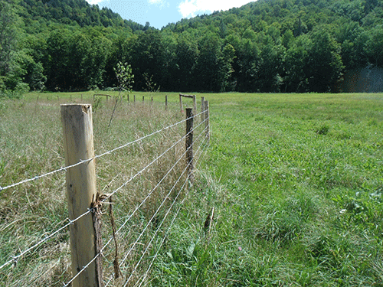
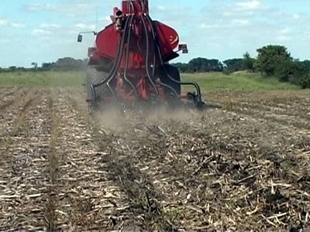
Increased buffers and manure setbacks
(25’ streams and 10’ ditches)
100’ on 10%+ Slope
Cover Crop Floodplains (broadcast by 10/1 or drilled by 10/15)
Required Agricultural Practices:
Certified & Uncertified SFOs
Establish standards for livestock exclusion from waters (3” minimum growth)
Manure Planning for Fields with Soil Test Phosphorus > 20 ppm

Slide 11
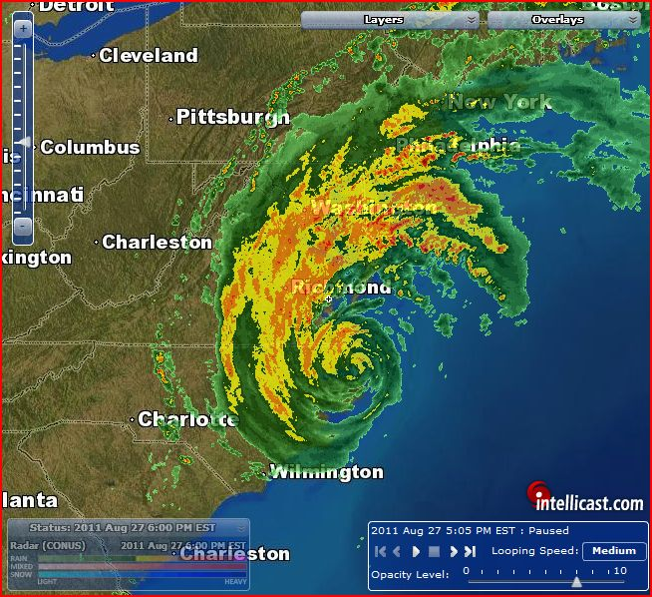
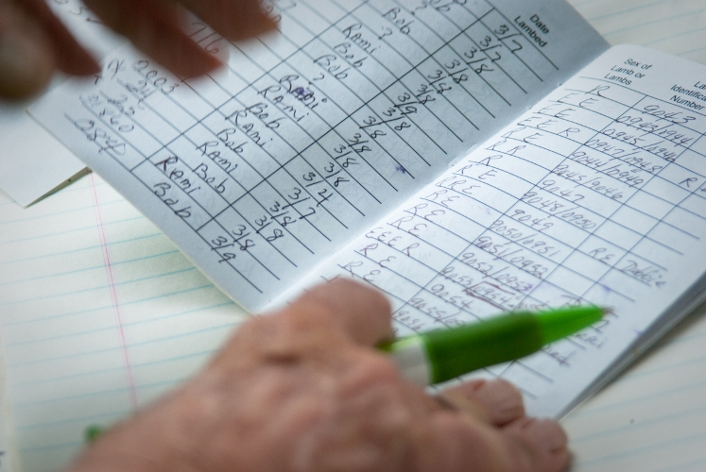
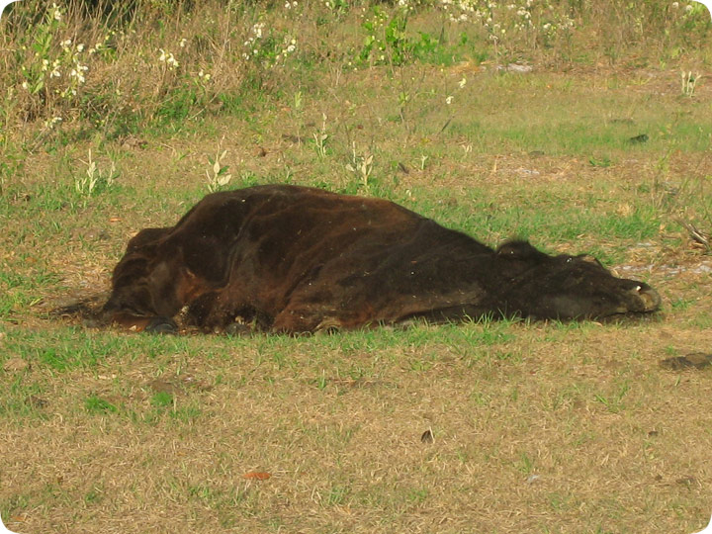
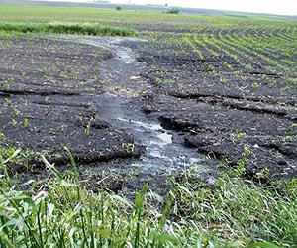
Weather conditions conducive to runoff
Record keeping requirements
Required Agricultural Practices:
Certified & Uncertified SFOs
Manage gully erosion and reduce overall erosion to T
Mortalities must be disposed in 48 hours
§5.3(b)
§5.8

Slide 12
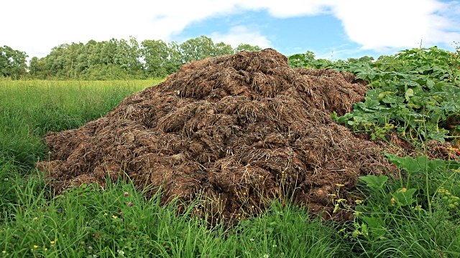
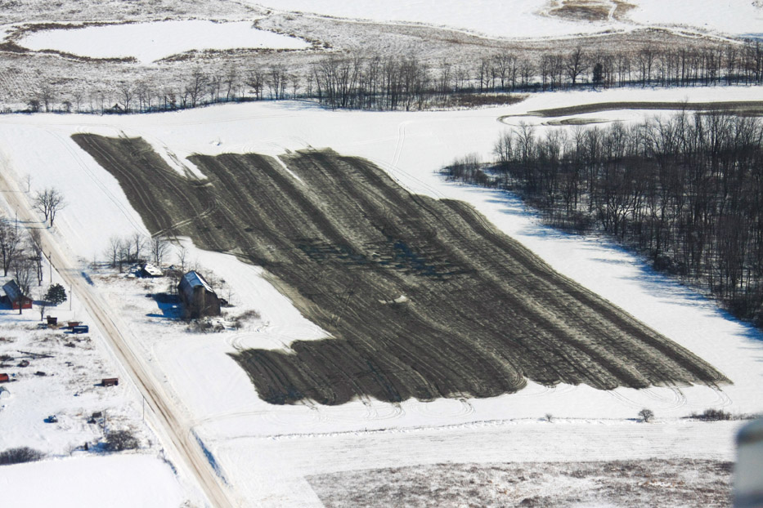
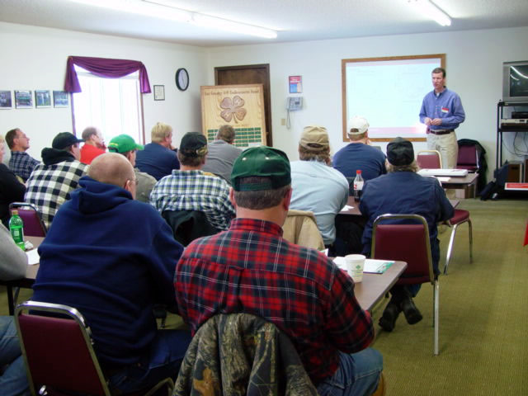
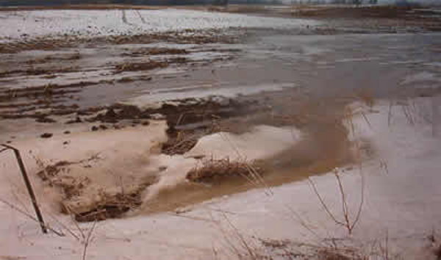
Seasonal winter spreading exemptions
Increased stacking setbacks from water and wells plus active management (2 years)
Required Agricultural Practices:
Certified & Uncertified SFOs
Train & license custom manure applicators
Extended winter spreading ban for annual crop in floodplains (10/15 to 4/15)

Slide 13
AGR.RAP@vermont.gov
Additional Information:
agriculture.vermont.gov/water-quality/regulations/rap
Or:
go.usa.gov/cdGew

Slide 14
Requirement of RAPs | Cost of Implementation | FA Available | C/S Rate | Supporting Benefit in addition to FA
Cover Crop Frequently Flood Annual Crop Fields | $89/ac (Seed = $40 / ac for 100# rate) | $67 /ac or $79/acre (NRCS EQIP Practice Code 340) | 75% to 90% | 40# N Credit in Spring or 1 T DM / Ac break even for double cropping
Nutrient Management Plan Development (CSFO) | $3,095 / 150 ac. farm | $2,321 / 150 ac. Farm (NRCS EQIP Practice Code 104) | 75% to 90% | University Programs available to support farmer development of their own plan 21.7% Average Fertilizer Usage decrease Post-NMP (Darby, 2016) Increases rate of adoption of supporting Conservation Practices
25' Vegetated Buffer on Surface Water | $468 / ac or $850 / ac | $680 / ac (NRCS Practice Code 512) | 75% to 90% | Numerous opportunities exist to support farmers in installing vegetated buffers on surface waters Many scenarios include consideration for 'forgone income' of changing land use (from corn to hay) Agency will be launching VT Critical Area Seeding & Filter Strip Program: available to pay for spot installation of grassed waterways, also to support farmers to leave hayable buffers when rotating from hay to corn

Slide 15
Vegetative Buffer Zone Programs
US Department of Agriculture (USDA) Natural Resources Conservation Service (NRCS) Environmental Quality Incentives Program (EQIP) has significant technical and financial assistance resources available to provide FA and TA to farmers to install vegetative buffer zones.
  Practice Code 512: Forage and Biomass Planting (Cool Season, Establish or Reseed, Foregone Income)
    Payment Rate $ 680.86 /Ac.
  Practice Code 393: Filter Strip (Filter Strip, Introduced species: Forgone Income)
    Payment Rate: $ 522.71 / Ac.
  Practice Code 386 :Field Border (Field Border-Native, Inc Forgone)
    Payment Rate: $ 624.58 / Ac.
Conservation Reserve Enhancement Program (CREP):
  It is important to note the CREP is used to install Riparian Forest Buffers—non-harvestable woody buffers. These buffers are above and beyond what is required by the RAPs.
  http://agriculture.vermont.gov/sites/ag/files/PDF/statewide%20crop%20average%20rate%20CREP%20brochure3a%20updated.pdf
  Total funds over the 15 year contract period: $2,005 + $2,820 = $4825/acre or $321.67/acre/yr.
Vermont Critical Area Seeding and Filter Strip Program
  http://legislature.vermont.gov/statutes/section/06/215/04900
  The Vermont Agency of Agriculture, Food & Markets will be developing policy and payment rates for this program to launch in the spring.
  This will be a state administered program that farmers would be able to use to implement harvestable vegetated buffers on their farms.
USDA EQIP
VAAFM Critical Area Seeding and Filter Strip Program
512: Forage and Biomass Planting
  (Cool Season, Establish or Reseed, Foregone Income)
  Payment Rate $ 680.86 /Ac.
393: Filter Strip
  (Filter Strip, Introduced species: Forgone Income)
  Payment Rate: $ 522.71 / Ac.
386: Field Border
  (Field Border-Native, Inc Forgone)
  Payment Rate: $ 624.58 / Ac.
Hayable Buffers
Grassed Waterway Establishment
Launch by spring 2015
Will Replace Vermont Ag Buffer Program
CREP
$4825/acre
or $321.67/acre/yr.

Slide 16
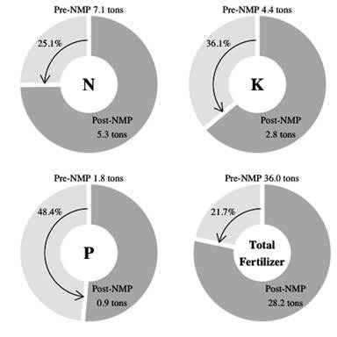
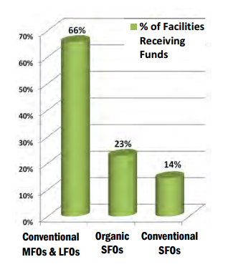
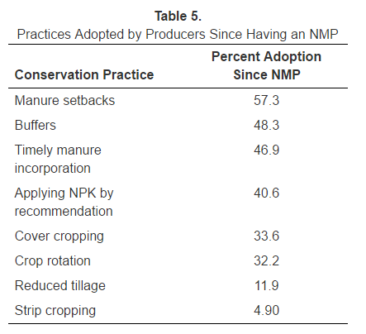
RAPs: Technical and Financial Assistance Opportunities

