Slide 1
Update on the new 2023 pesticide rule
Matt Wood, Vermont Golf Course Permit Specialist

Slide 2
What I’ll cover today…
STORAGE REQUIREMENTS for pesticides.
Uncertified applicators and federal RUP use. Definition of “USE”.
Review of record keeping and permit requirements.

Slide 3
11.02 Pesticide and Container Storage by Applicators…
Applicators shall ensure…
(a) Any pesticide shall be stored in accordance with requirements and precautionary storage instructions contained on the product label.

Slide 4
11.02 Pesticide and Container Storage by Applicators…

Slide 5
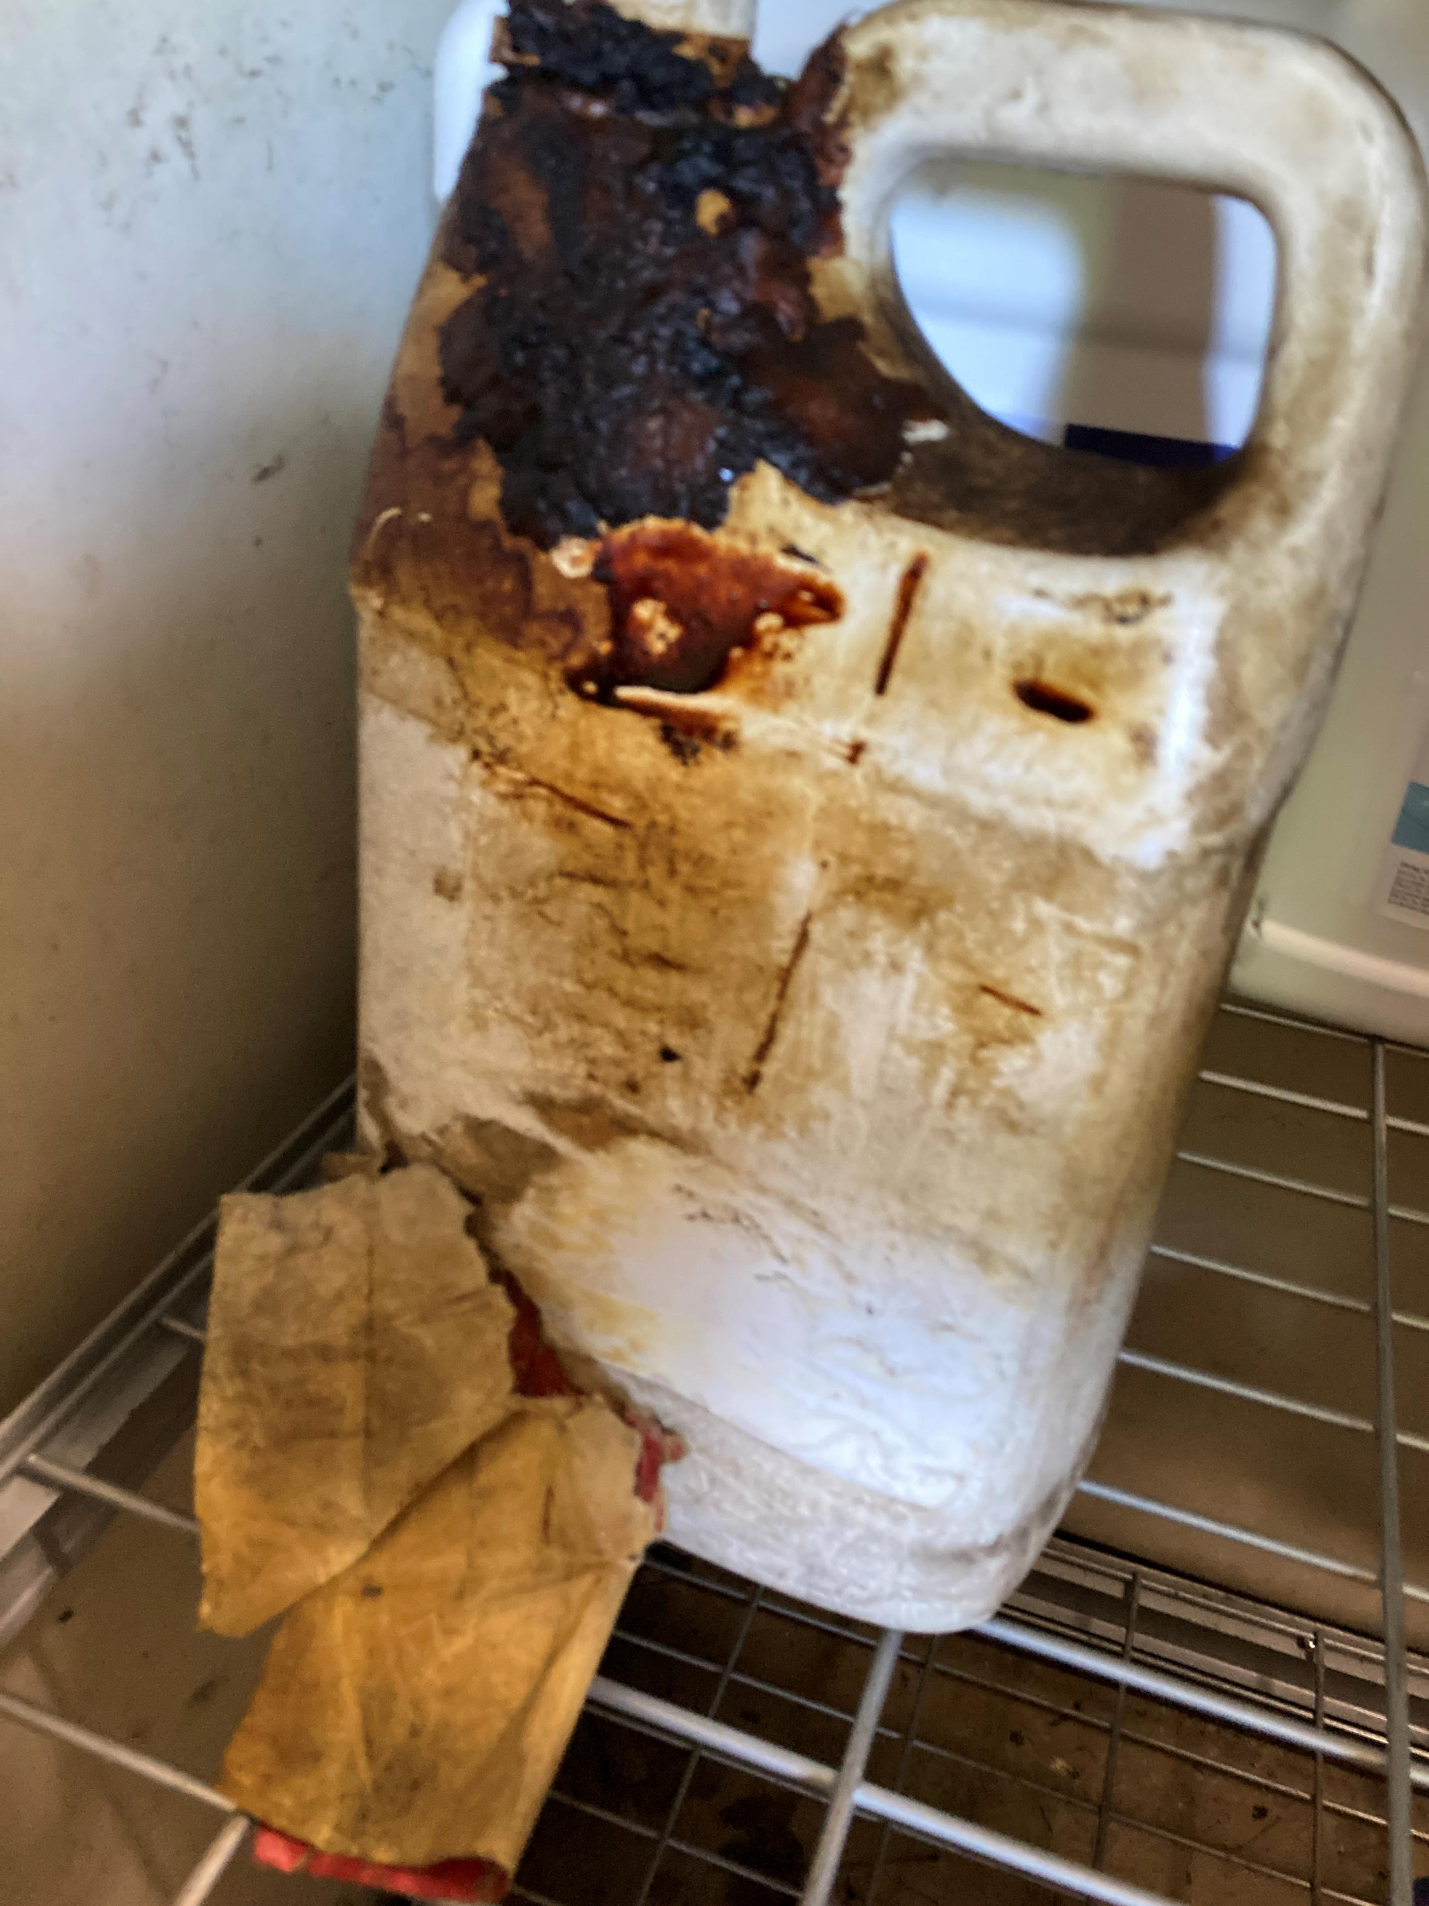
11.02 Pesticide and Container Storage by Applicators…
Applicators shall ensure…
(b) Any container shall have a legible manufacturer label indicating the contents.

Slide 6
11.02 Pesticide and Container Storage by Applicators…
Applicators shall ensure…
(c) Any pesticide or container that has not been triple rinsed shall be stored in a separate room and in such a manner as to prevent contamination to food, feed, seed, livestock remedies, drugs, plants, and other products or materials from the volatilization of a pesticide, the leakage or breakage of containers, or other causes.

Slide 7
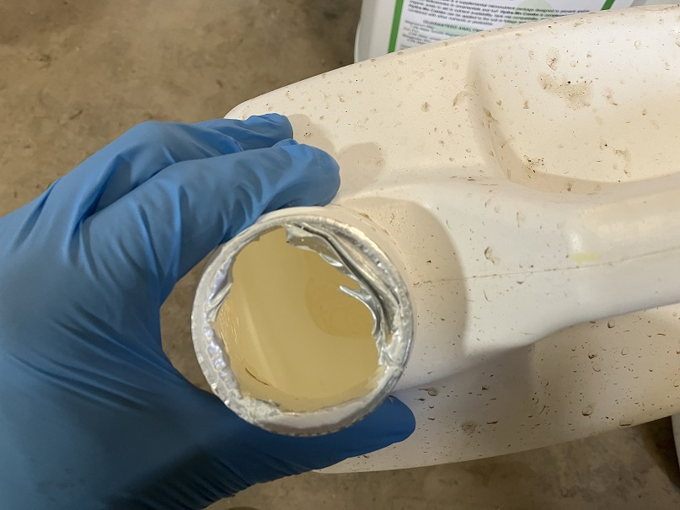
11.02 Pesticide and Container Storage by Applicators…

Slide 8
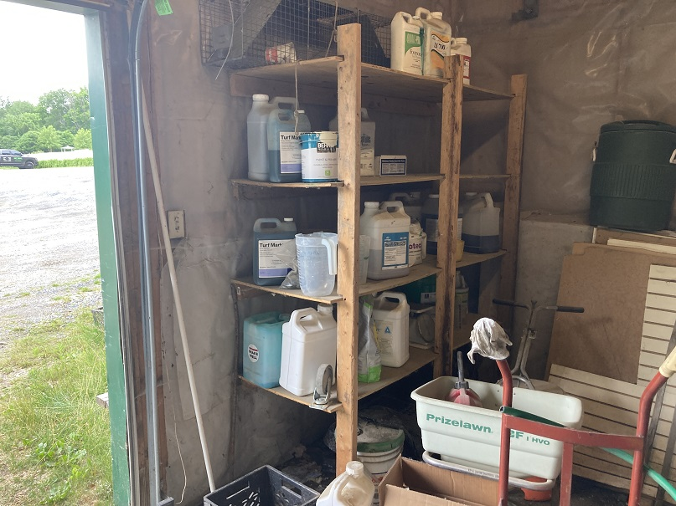
11.02 Pesticide and Container Storage by Applicators…
Applicators shall ensure…
(d) Any pesticide shall be stored inside and protected and secured in such a manner to prevent access from unauthorized persons and wildlife.

Slide 9
11.02 Pesticide and Container Storage by Applicators…
Applicators shall ensure…
(e) The floor surface of the pesticide storage area shall be smooth, facilitating the complete recovery of any discharge. Floor surfaces may include sealed concrete and plastic.

Slide 10
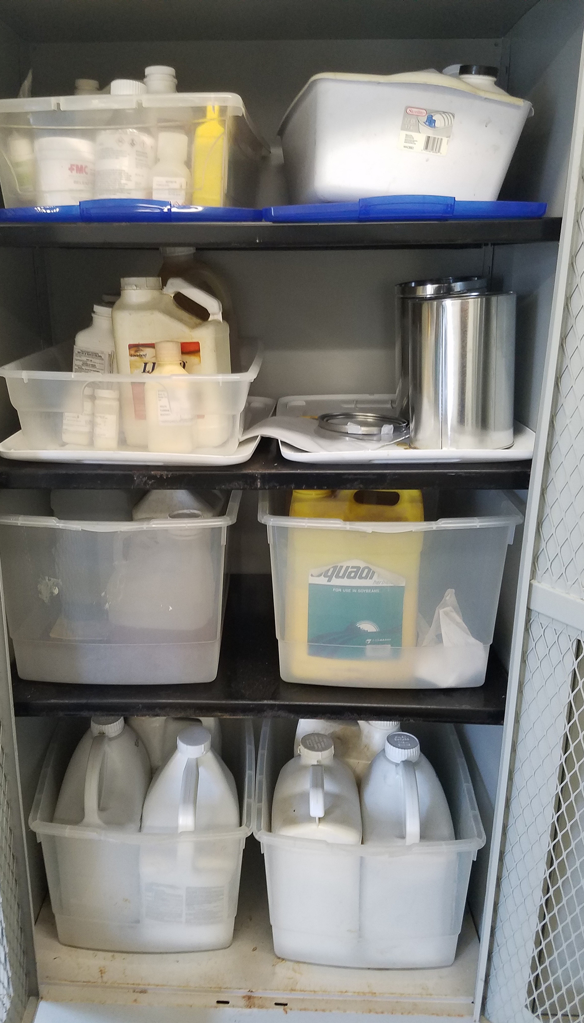
11.02 Pesticide and Container Storage by Applicators…
Applicators shall ensure…
(f) Earthen floors shall be prohibited in a pesticide storage area unless all containers are placed in a containment vessel designed to recover and contain any discharge.
(Photo: Ric Bessin,UK).

Slide 11
11.02 Pesticide and Container Storage by Applicators…
Applicators shall ensure…
(g) The pesticide storage area shall be identified by legible signage clearly indicating that a pesticide is in storage, as follows:
(1) Sign(s) shall include the word "Warning," "Danger," or "Pesticides" followed by wording that indicates a pesticide is in storage.
(2) Lettering of the words "Warning," "Danger," or "Pesticides" shall be a minimum of one and 1/2 inches in height.

Slide 12
11.02 Pesticide and Container Storage by Applicators…
https://www.safetysign.com/products/6655/danger-pesticide-storage-sign

Slide 13
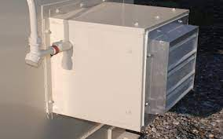
11.02 Pesticide and Container Storage by Applicators…
Applicators shall ensure…
(h) The pesticide storage area shall be adequately vented to the outdoors prior to entry.

Slide 14
11.02 Pesticide and Container Storage by Applicators…
Applicators shall ensure…
Containment vessels used for pesticide storage and handling shall be of materials and construction compatible with the pesticide stored and the conditions of storage and maintained in a manner as to minimize the possibility of a discharge.
High-density polyethylene (HDPE)

Slide 15
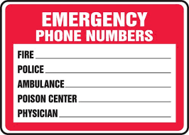
11.02 Pesticide and Container Storage by Applicators…
Applicators shall ensure…
(j) In conjunction with pesticide storage, ambulance and fire department phone numbers or the 911 number shall be displayed at a central location where all persons have access.

Slide 16
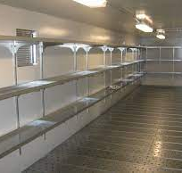
11.02 Pesticide and Container Storage by Applicators…
Applicators shall ensure…
(k) A pesticide storage area shall maintain sufficient lighting to allow the observation of containers and their labeling.

Slide 17
11.02 Pesticide and Container Storage by Applicators…
Applicators shall ensure…
(l) Storage of pesticide in bulk shall comply with the bulk pesticide storage rules under Section 12.
“1.09 Bulk Pesticide means liquid pesticide in a container larger than 210 gallons (795 liters) or dry pesticide in undivided quantities greater than 100 pounds (45 kilograms), and includes mini-bulk pesticide containers, except as otherwise specified.”

Slide 18
11.02 Pesticide and Container Storage by Applicators…
Applicators shall ensure…
(m) Cabinets, storage bins, lockers, or similar type storage compartment shall be considered a pesticide storage area provided that the storage compartment complies with subsections (a) – (d), and (i) – (k) of this section.
In other words,… (e-h) don’t apply = floor surface materials, lighting, ventilation requirements.

Slide 19
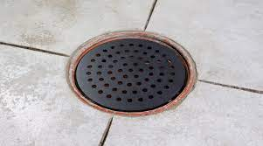
11.02 Pesticide and Container Storage by Applicators…
Applicators shall ensure…
(n) Floor drains not used in conjunction with catch basins shall be prohibited in a pesticide storage area.

Slide 20
11.02 Pesticide and Container Storage by Applicators…
Applicators shall ensure…
(o) A pesticide storage area may be equipped with a catch basin, provided that:
(1) there are no pipes attached;
(2) it is constructed for complete recovery of a discharge; and
(3) it is located within the floor where liquids can be transferred to an above ground container in the event of a spill or discharge onto the floor.

Slide 21
11.02 Pesticide and Container Storage by Applicators…

Slide 22
11.02 Pesticide and Container Storage by Applicators…
Applicators shall ensure…
(p) A pesticide storage area shall be maintained in a clean condition.
(q) At a minimum, any discharge shall be cleaned up within 60 minutes.

Slide 23
11.02 Pesticide and Container Storage by Applicators…
Applicators shall ensure…
(r) Any container, held by an end user, having the capacity for holding greater than 55 gallons but less than 300 gallons of bulk pesticide, known as mini-bulk containers, shall be exempt from subsections (c), (e) – (h), (j) – (p) of this section provided that:
(1) the container is identified with pesticide labeling that is affixed to the mini-bulk container by the dealer or person who sold or distributed the product;

Slide 24
11.02 Pesticide and Container Storage by Applicators…
Applicators shall ensure…
…
(2) there is a mechanism attached to the container for the purpose of securing the dispensing apparatus; and
(3) within 90 days of receipt of the pesticide in the mini-bulk container, the container is returned to the dealer.

Slide 25
11.02 Pesticide and Container Storage by Applicators…

Slide 26
11.02 Pesticide and Container Storage by Applicators…
Applicators shall ensure…
(s) The following minimum buffer distances are maintained around any public water source:

Slide 27
11.02 Pesticide and Container Storage by Applicators…
Applicators shall ensure…
(s) The following minimum buffer distances are maintained around any public water source:
100-foot buffer for all public non-community groundwater drinking water sources; and
This is a well, spring, dug well, etc. that serves a country club with fewer than 25 employees.
Non-Transient Non-Community (NTNC) water system serves 25 or more of the same people for 6 months or more. Schools, business parks, or offices served by their own on-site source of water.

Slide 28
11.02 Pesticide and Container Storage by Applicators…
Applicators shall ensure…
(s) The following minimum buffer distances are maintained around any public water source: ...
(2) 200-foot buffer for all public community drinking water sources and intakes, and surface water public non-community drinking water intakes.
“City water” = 15 or more connections or serving 25 or more people in residential/year-round setting. (condo well, or intake in lake or river)

Slide 29
11.02 Pesticide and Container Storage by Applicators…
Applicators shall ensure…
(s) The following minimum buffer distances are maintained around any public water source:
Pesticide Use vs. Storage

Slide 30
5.03 General Requirements for Applicators, Licensed Companies, and Dealers
(a) A federally restricted use pesticide shall only be used by a certified applicator.
Translation: no longer can “supervise” applicators spraying a federally restricted use pesticide.

Slide 31
Section 1. Definitions
1.71 Use means:
(a) pre-application activities involving mixing and loading a pesticide;
(b) applying a pesticide, including supervising the use of a pesticide by a noncertified applicator;
(c) other pesticide-related activities, including transporting or storing a pesticide container that has been opened, cleaning equipment, and disposing of any excess pesticide, spray mix, equipment wash water, a pesticide container, and other pesticide-containing material; or
(d) recommending the use of a pesticide.

Slide 33
Record Keeping
Pesticides
Fertilizers

Slide 36
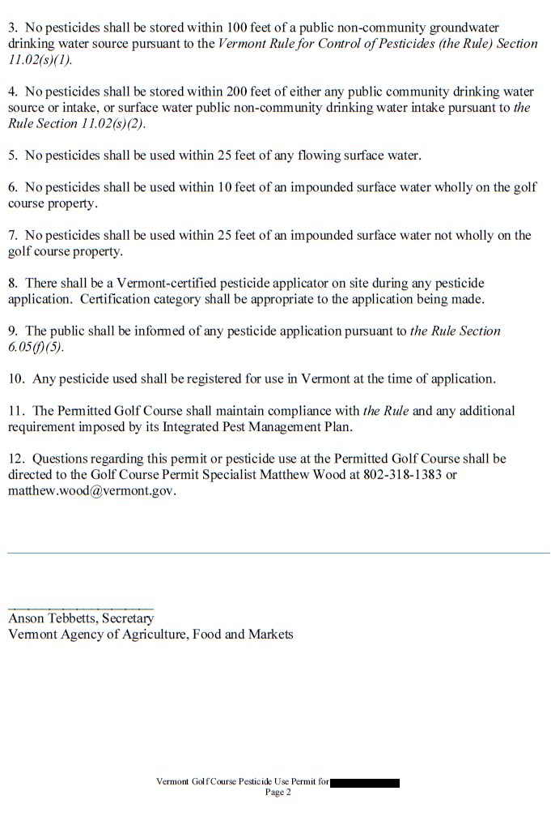

Slide 38
My contact info…
Matthew Wood
802-318-1383
matthew.wood@vermont.gov

