Slide 1
SMALL FARMER INPUT
To the PES Working Group
Stephen Leslie-Cedar Mountain Farm
December 2021

Slide 2

We protect what we love

Slide 3
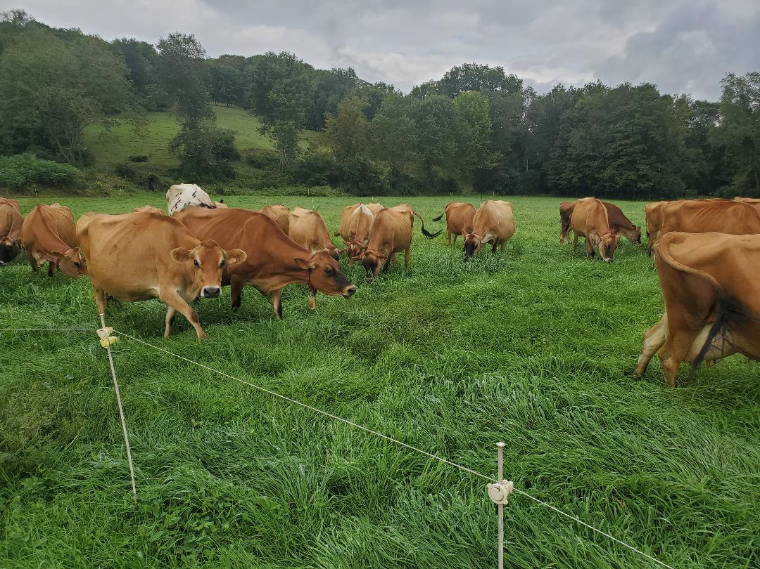
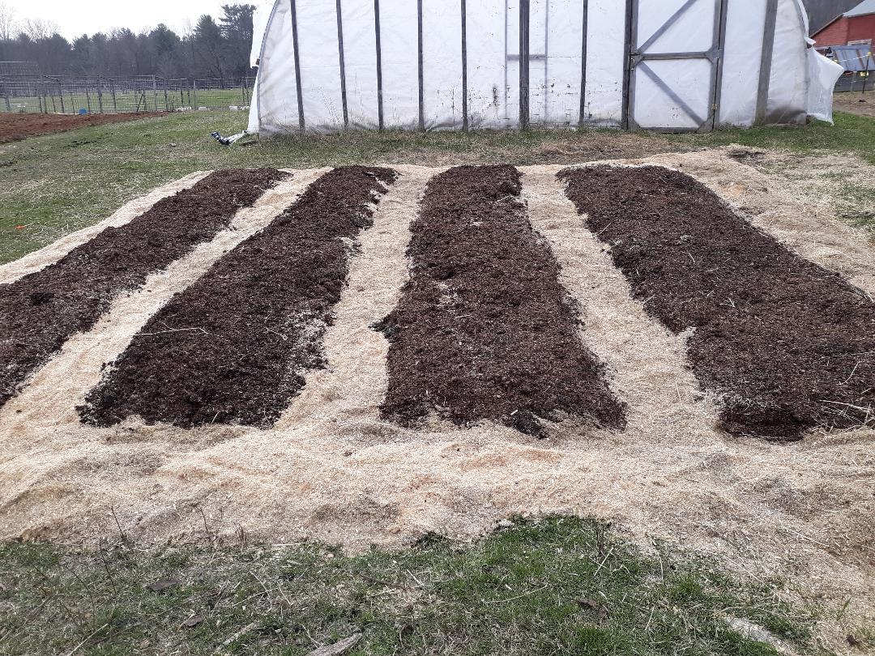
WHY VERMONT NEEDS A HEALTHY SOIL PROTECTION & RESTORATION ACT

Slide 4
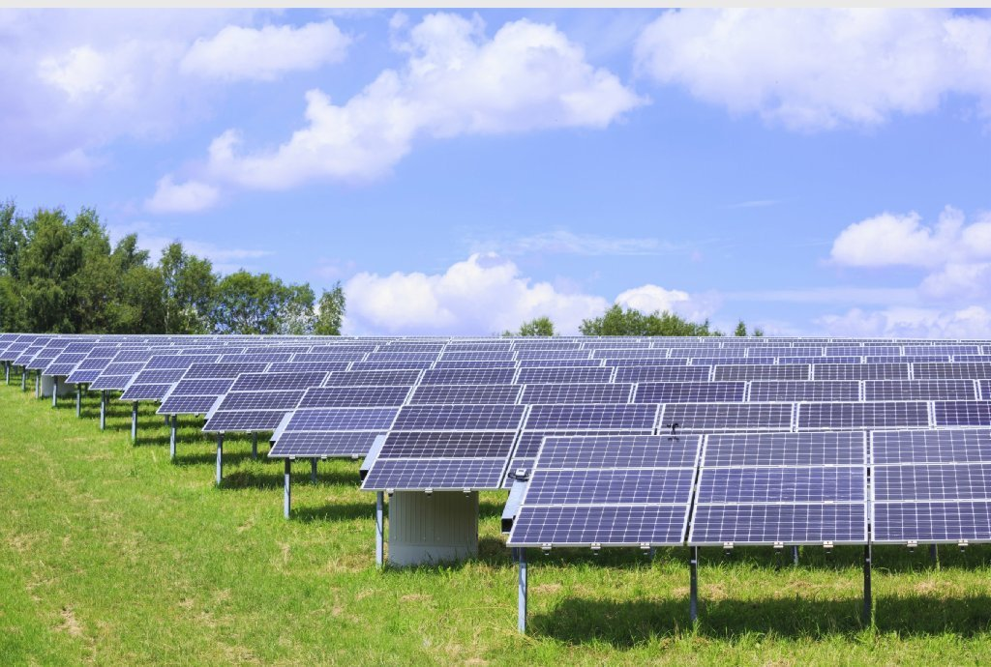
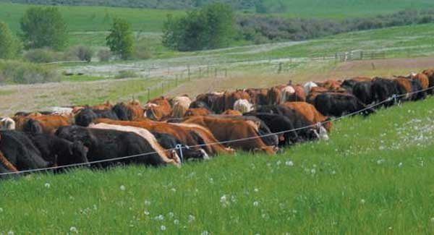
To meet our binding greenhouse gas emission reduction targets as established under the passage of the VT Global Warming Solutions Act we need to elevate healthy soil as an essential ingredient to respond realistically to the climate and ecological crisis. Simply reducing GHG emissions won’t be enough to stave off the worst scenarios of abrupt climate change.

Slide 5


In 1972, under pressure from a burgeoning environmental movement, the Nixon administration passed the Clean Air & Clean Water Protection Acts and established the EPA.

Slide 6
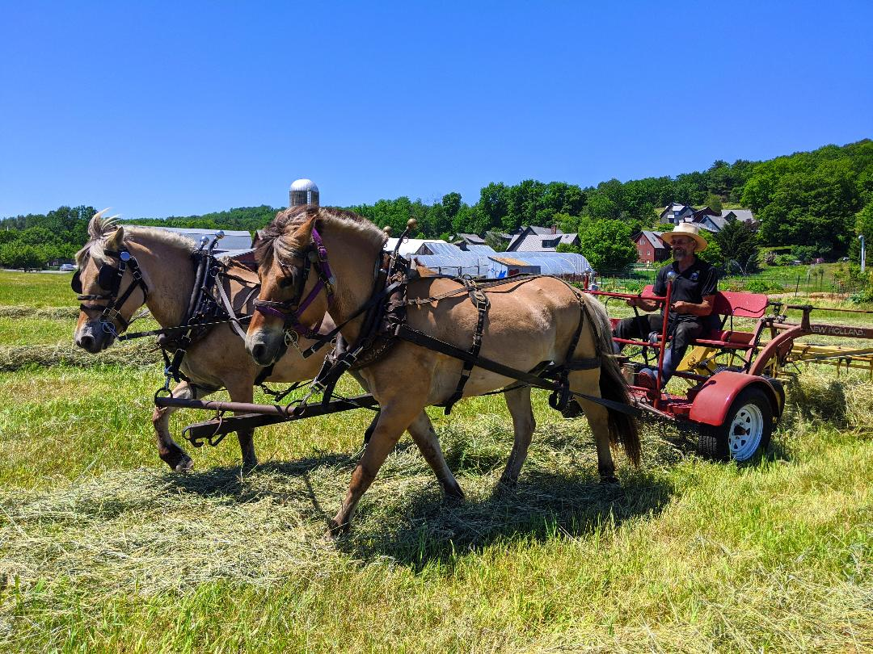
Although a landmark victory for the environment, this was a clear case of putting the cart before the horse: until we pass a Healthy Soil Protection and Restoration Act, we cannot have clean air and water---it is not possible without healthy soil.

Slide 7
Our only real wealth as a civilization is our soils. The state has a fiduciary responsibility to protect and restore our soil resources by providing a base income to land managers who can regenerate soil while producing food, fuel, fiber, building materials, and medicine.

Slide 8

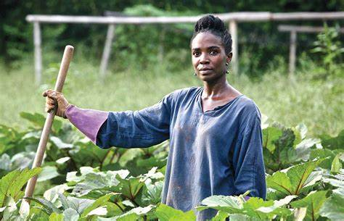
In this era of ecological collapse, regenerative land managers are our frontline essential workers.

Slide 9
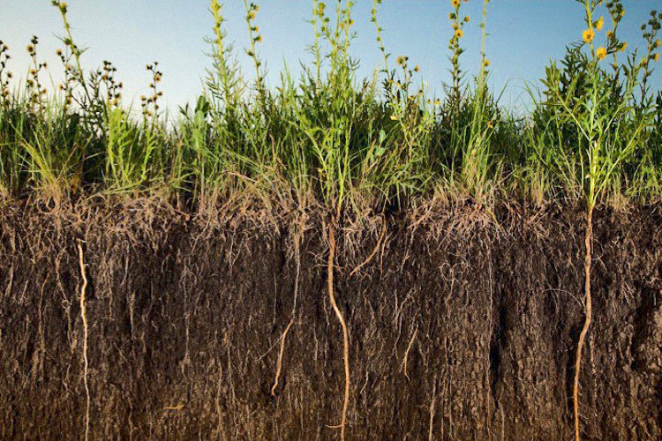
We need progressive soil health policy reflective of a radical shift in societal priorities---where soil is recognized as “basic infrastructure”.

Slide 10
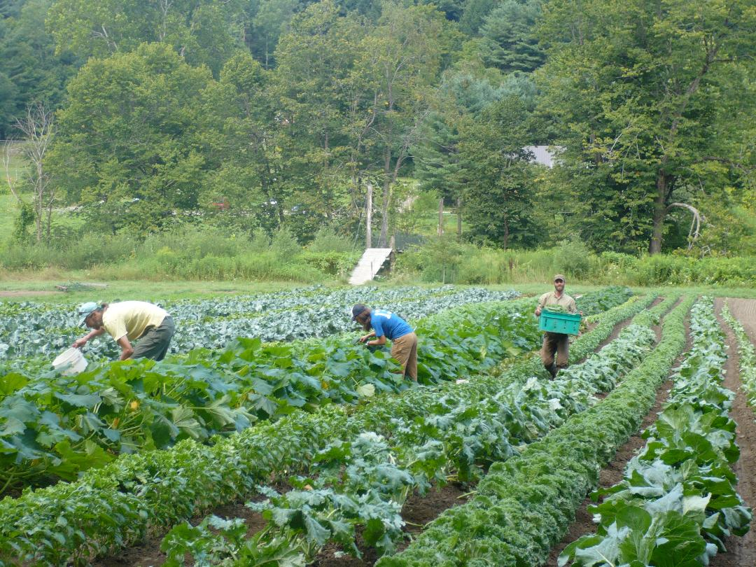
We must decouple organic-regenerative farming from the capitalist system, or at least provide sufficient safety nets to guarantee a living wage for all farmers and farm workers engaged in organic regenerative land management.

Slide 11
To implement the VT Healthy Soil Protection & Restoration Act we should incentivize the adoption of:
SOIL HEALTH MANAGEMENT SYSTEMS

Slide 12
Ownership or leasehold or any other form of land tenure can no longer mean free license to degenerate or destroy soil. Government must protect this critical resource and offer transformational incentives for the adoption and maintenance of soil health management systems.

Slide 13
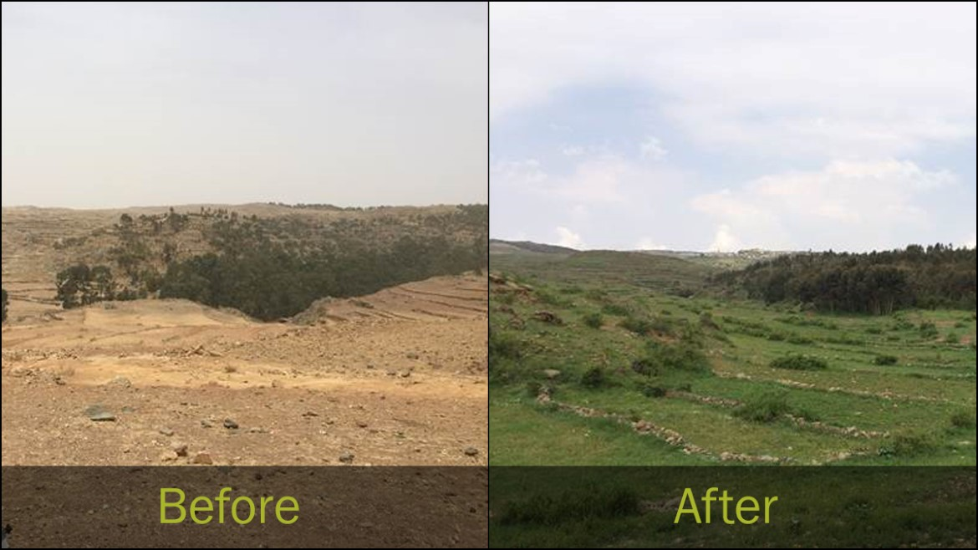
Using the Nutrient Management Plans as a model, state, federal agents, and independent consultants can assist land managers in developing soil health plans. The aim is for long term adoption of practices with commensurate long term financial incentives and technical assistance.

Slide 14
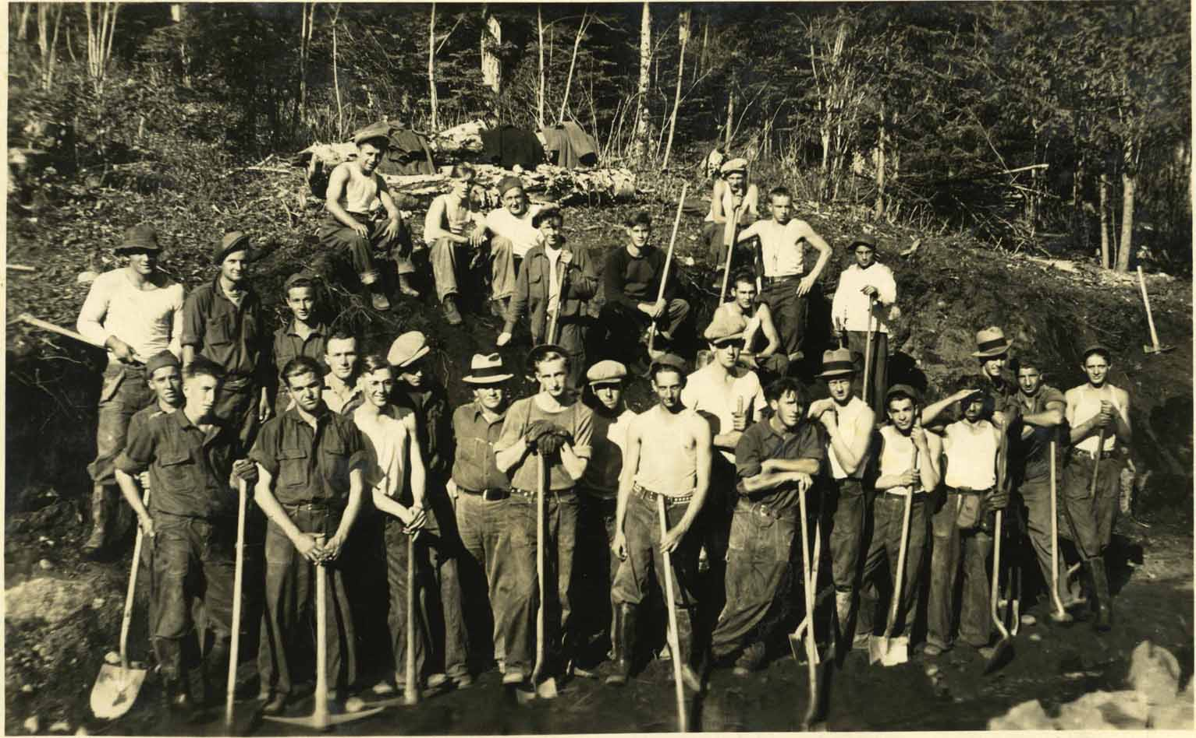
Field agents can do yearly site visits and regular follow ups to monitor and assist in the implementation of practices.

Slide 15
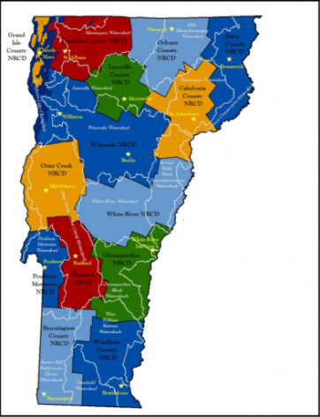
The strategy is to coordinate already existing state, federal & NGO programs in order to amplify the collective impact of all these efforts exponentially. We can build out the regional Conservation District offices to coordinate delivery of technical assistance in each major watershed.

Slide 16

The six basic principles of soil health, first developed by the NRCS, provide a rubric for the adoption of healthy soil practices.

Slide 17
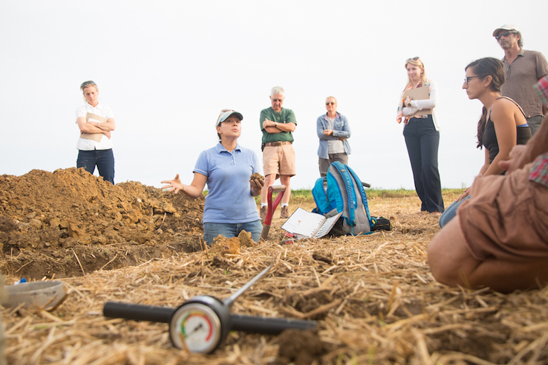
Each land manager would have a “team” of experts to help implement and troubleshoot. This team could coordinate with the Farm Viability Program to strive for successful outcomes at every level. Site characteristics and social context will be taken into account to ensure an equitable and just transition toward organic regenerative management.

Slide 18
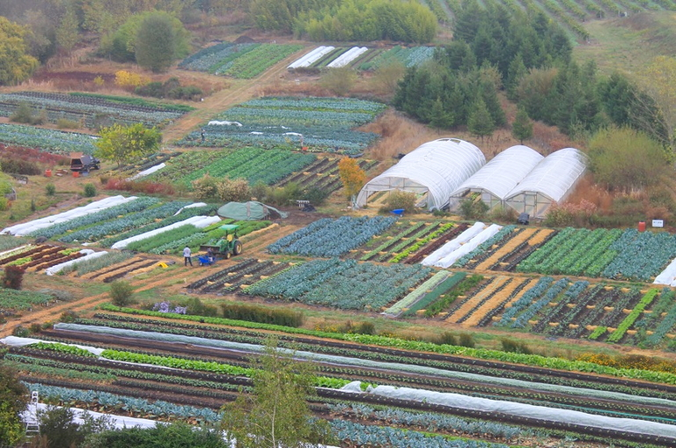
All practices should be seen as comprising a synergy of effects to restore the totality of landscape functions of the farm or forest ecosystem. Incentives will no longer be granted piecemeal for specific practices---rather participants are aided to develop comprehensive plans.

Slide 19
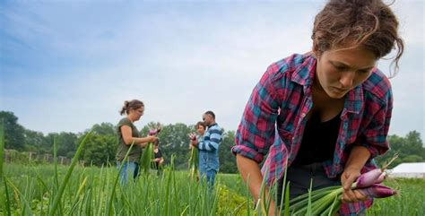
Soil Health Management Systems would allow for the land manager to apply for assistance on a variety of practices under a single contract. This would increase enrollment and voluntary compliance with Required Agricultural Practices. Incentives are a favorable approach over regulations. Successful pilot projects and farmer-to-farmer training are proven methods for accelerating the adoption of healthy soils practices among the legacy farming community.

Slide 20
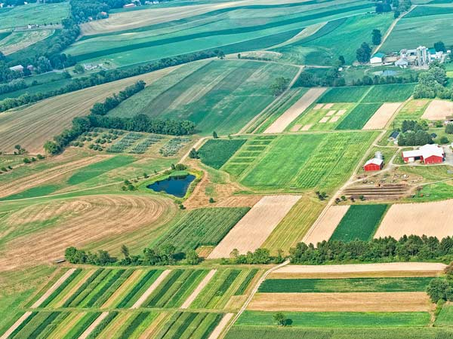
It is not practical to measure carbon sequestration, water quality and other enhanced functions on every farm every year. Therefore UVM should continue to conduct trials and monitor pilot farms to establish median averages resulting from the implementation of soil health plans. Farmers will be expected to document practices.

Slide 21
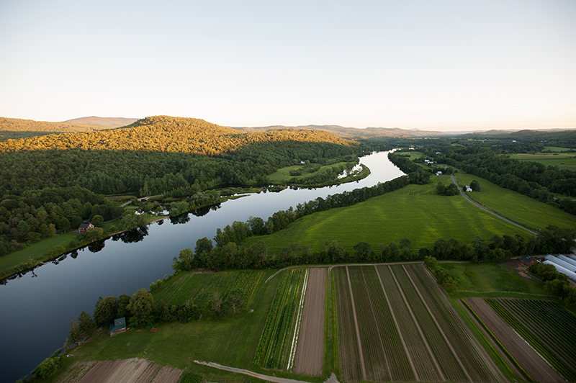
Let’s ensure that payment for ecological services is not restricted to cleaner water and carbon sequestration. We need a holistic measure of the ecological and economic benefits farmers contribute to society. We need to take into account all of the landscape functions of a farm or forest and how restoring these contributes to the health of the bioregion.

Slide 22
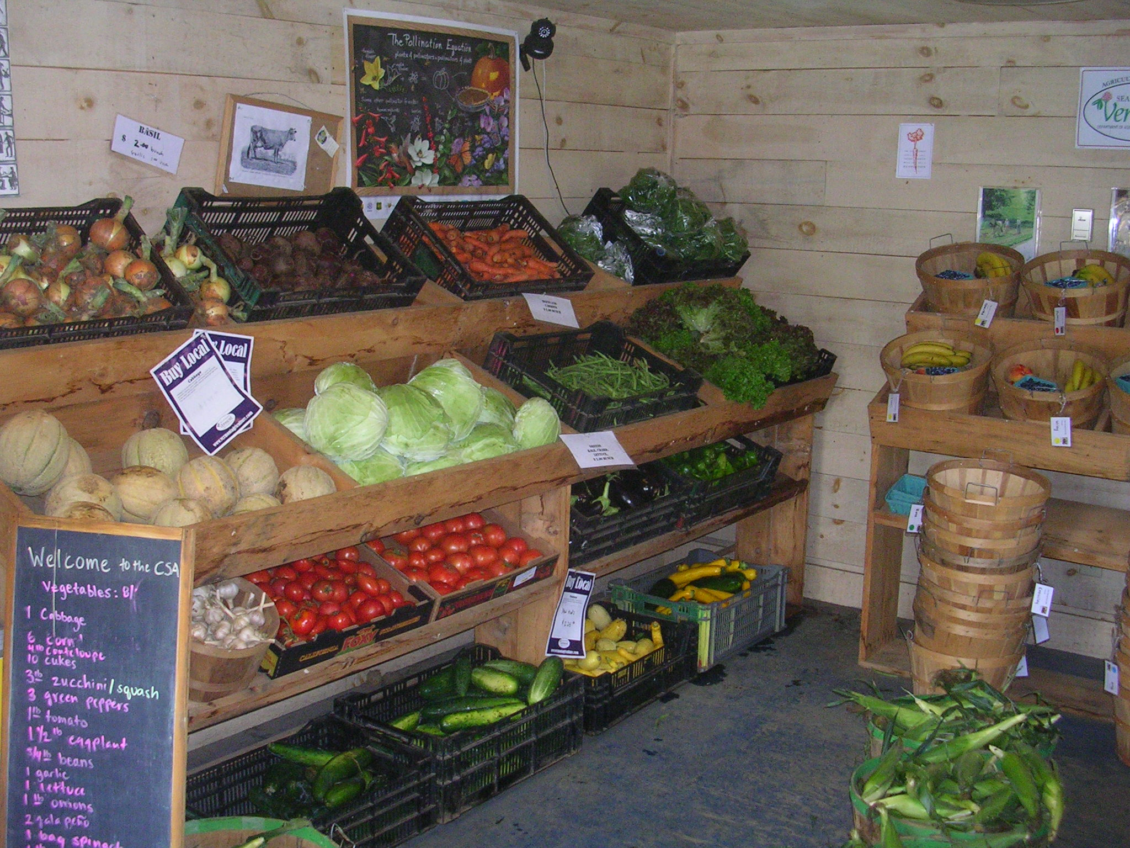
Not only do local organic regenerative farms build soil, infiltrate more water, and restore habitat, they also reduce the overall carbon footprint associated with food production by eliminating chemical inputs, reducing tractor use, and reducing transportation through local distribution.

Slide 23
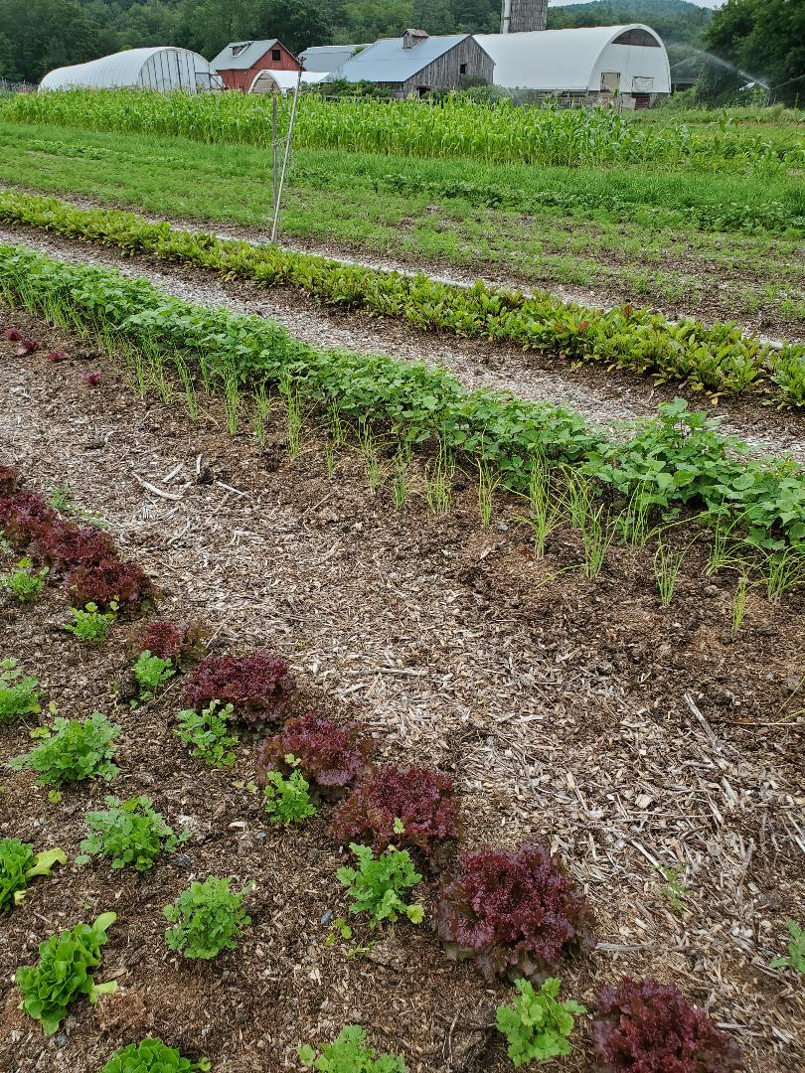
Carbon farming is a long term proposition. Every farm will experience ebbs and flows in sequestration, but there is not a farm in Vermont that can’t build more soil organic matter. It is this cumulative effect that is exponentially important and why payment should be equitable across the board for all land managers participating in soil health management regardless of acreage.

Slide 24
Payments to farmers could be direct or a combination of direct payments for adoption of SHMS along with programs to create equity in the market, such as; price parity for local farm products, regional supply management of milk and other commodities, and whole farm revenue insurance.

Slide 25
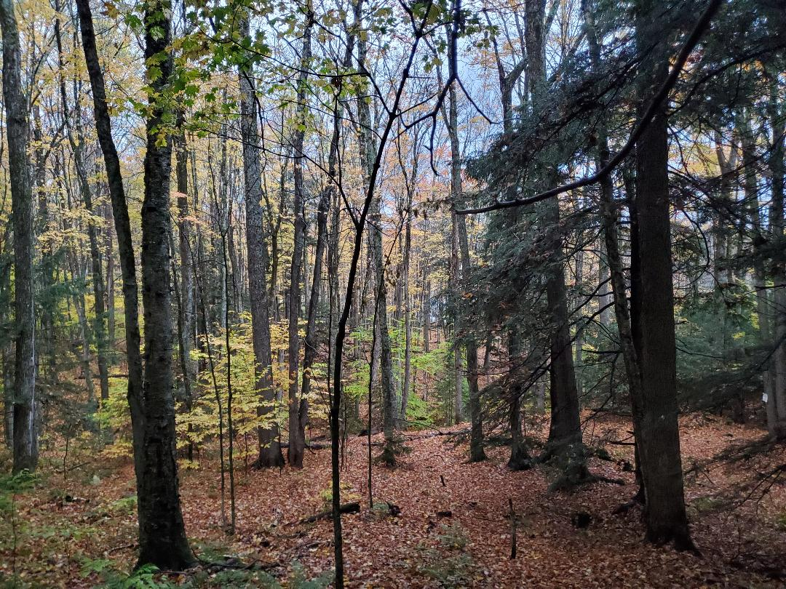
We need to place our attention equally upon the forestry sector. Worldwide 50% of the carbon stored in forests is held by the top 1% of the biggest trees. New findings show that, although it is not as rapid as in young trees, sequestration is greatest from the growth period of 50 years to 150 years of age and is continuous after that. The soil biome of an old growth forest is so robust that an estimated 60% of the carbon is stored below the ground.

Slide 26
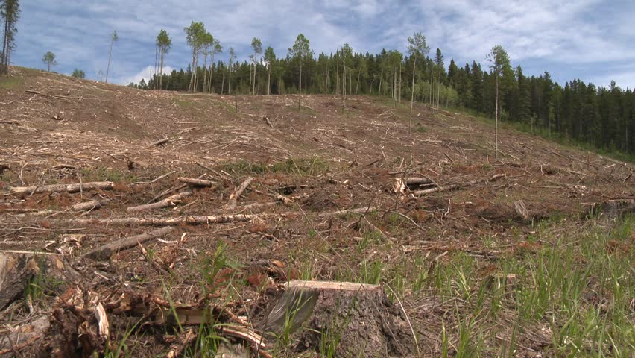
Beginning in 2010, for the first time in over one-hundred years, Vermont is again losing forest to the tune of 1500 acres a year. Unchecked development, clear cutting and fragmentation all threaten the health of our woodlands.

Slide 27
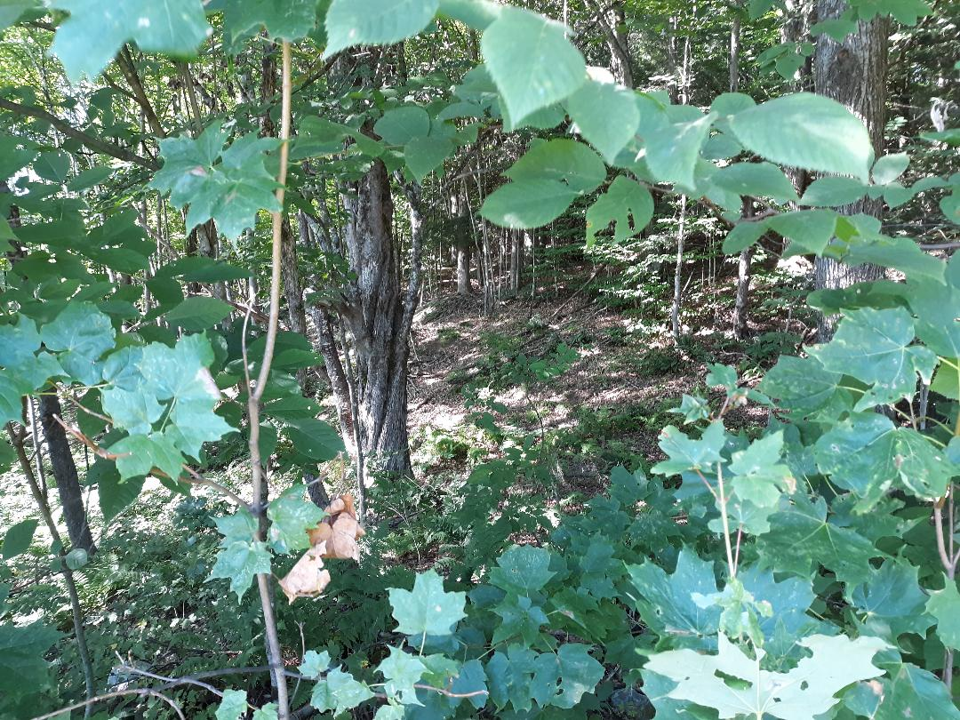
Let’s ensure that Ecological Forest Management become a required practice of Current Use and make re-wilding and proforestation accepted practices for restoring bio-diversity and building up our strategic carbon reserves.

Slide 28
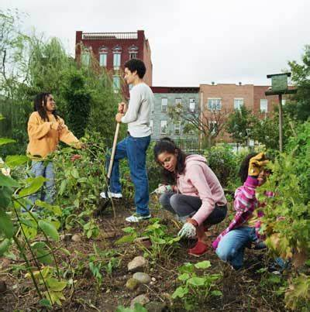
Healthy soil practices are applicable in suburban and urban settings, too. Cities, towns and villages may implement healthy soil plans by creating more green spaces, community gardens and food parks. Water infiltration can be improved by establishing riparian buffers and replacement of asphalt and concrete with permeable surfaces. Urban grey water and run-off can be filtered through living filtration systems. Property managers and homeowners who practice organic regenerative yard care have an important role. On-farm and municipal composting can put us on track toward a circular economy and a zero-waste society.

Slide 29
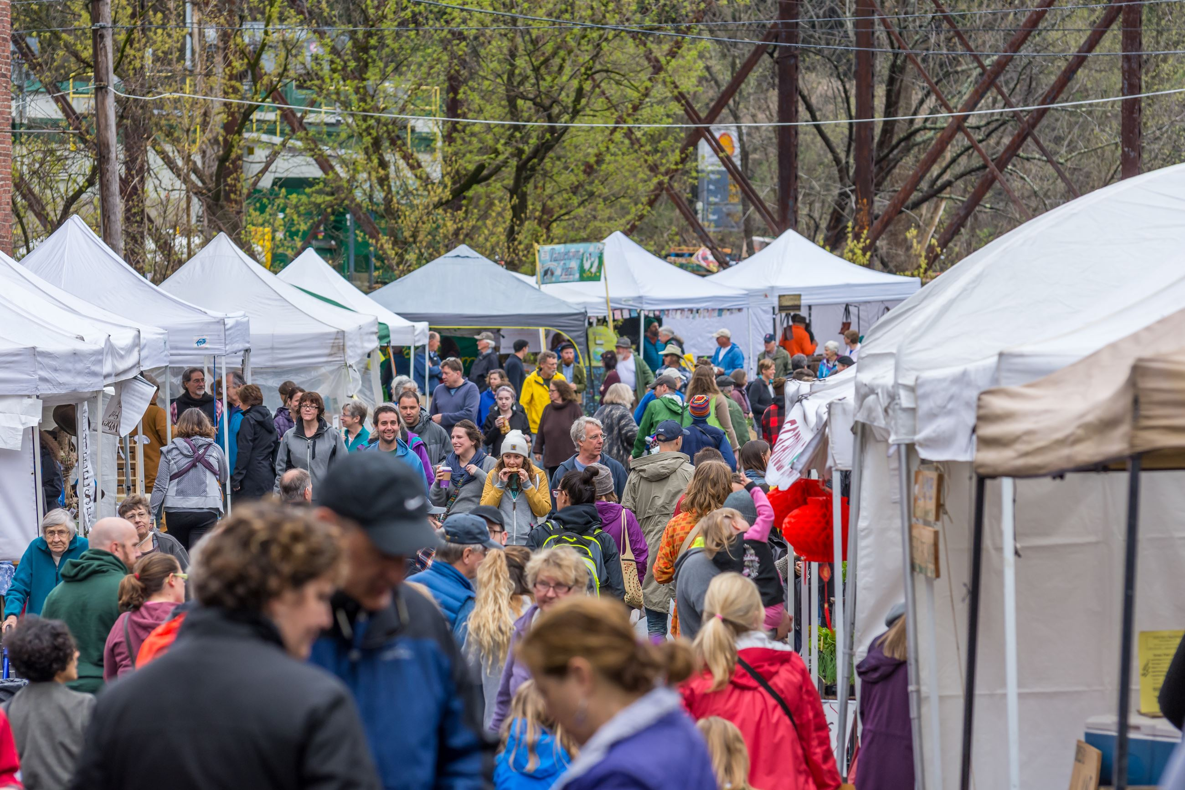
A regenerative farm renaissance could boost Vermont’s agri-tourism industry. Imagine our hills and valleys graced with a tapestry of organic regenerative diversified farms and regional food hubs. Tourists could travel hub-to-hub in electric buses charged by on-farm renewables to experience the specialty products of each region. We could become the “Napa Valley” of the organic regenerative movement. New and young farmers would flock here to attend Ag schools and intern on our farms, processing plants & abattoirs.

Slide 30
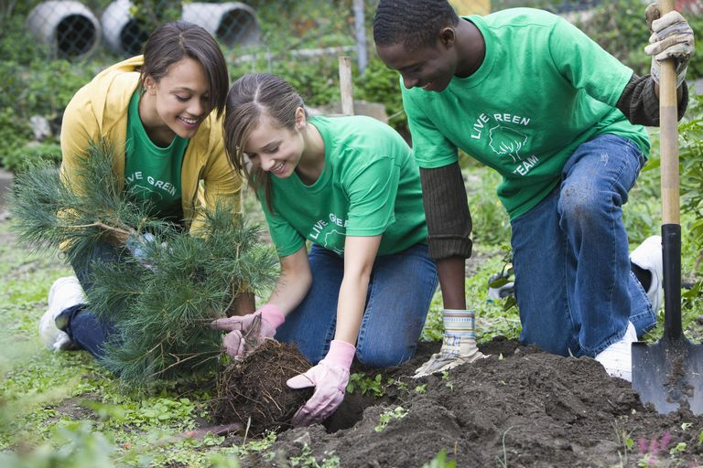
We could resurrect the New Deal era Soil Conservation Corps as the Soil Regeneration Corps and engage young people in planting trees and restoring habitat.

Slide 31

At the same time we could create opportunities to resettle climate refugees from the global south by offering access to land for farming and good-paying jobs in the growing food service sector. We could establish "new commons" through partnership between government, NGO's and land owners, to grant access to land to climate refugees, young and new farmers, indigenous population, people of color, women farmers, and others historically excluded from land tenure.

Slide 32

But for any of this to happen we need to elevate healthy soil as the essential ingredient to surviving the climate and ecological crisis.

Slide 33
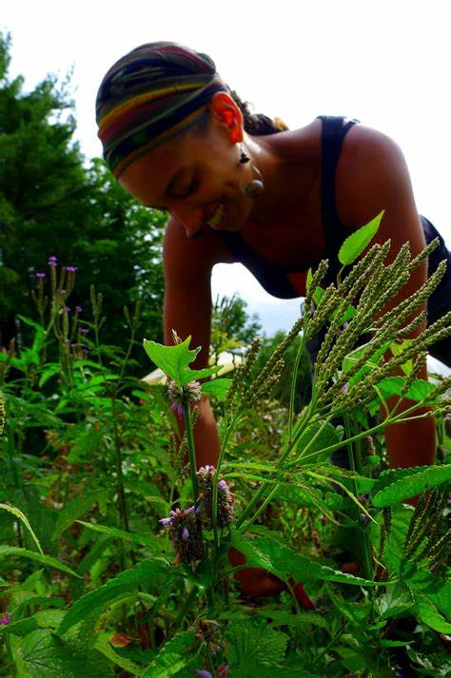
SOIL IS LIFE!

