Slide 1
Conservation Technical Assistance
(TA Teams)
Presented by: Jennifer Byrne, District Manager
White River Conservation District
www.whiterivernrcd.com
Presented to: VT Soil Health and PES Working Group
Date: October 19, 2021

Slide 2
60 Cows
On Main VT Route
Active Farmstand

Slide 3
Manure pile blocking barn exits
Cows are stuck in the barn
Broken manure gutter cleaners
Leaking water in barn
No manure stacking pad/pit
No additional funds
Yes, that’s a spring fed pond
No, that is not a stream.
Herein lies the problem.
Yes, that’s a wetland
Sandy soil
Across road & railroad from CT River
Corn Fields along river
P Level too high to spread
Must Export Manure
*Not considered high priority water quality concern* = Hard to rank for funding

Slide 4
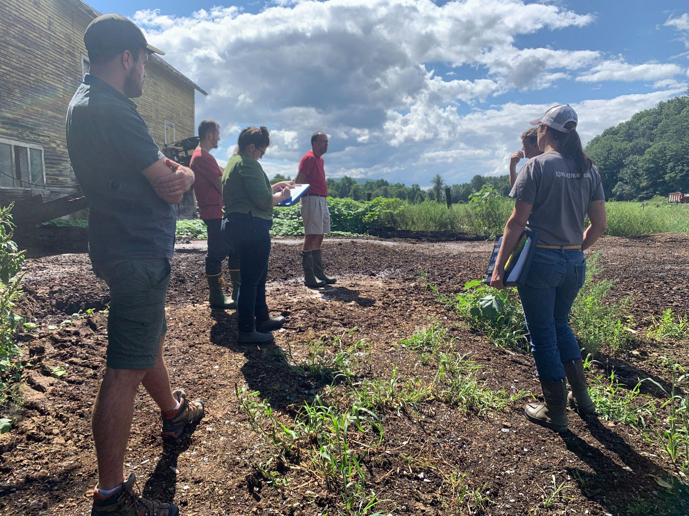
Timeline 2017 - 2021
2017-18
State Funded Milk House Waste System, received
Applied for Farm Viability assistance, not received
2018 Accessed UVM Nutrient Management Planning class through the Conservation District. Received one on one assistance with writing the plan, taking soil and manure samples, calibrating manure spreader.
‘19-’20 Could not sign off on NMP due to farm succession issues.
Ineligible for manure management funds; RAP compliance
District Conservation Specialist worked hand in hand with family members to update and build a plan that was in compliance.
Farmers rent no-till drill to establish more hay/pasture fields
Total CD Farm Visits/Meetings: 26
12/2020 Begin application process for state BMP program
02/2021 Applied to state CIG PFP Program, accepted
03/2021 NMP Certified
03/2021 - Apply for VHCB Water Quality Grant for manure storage/gutter cleaners, not received
- Apply for State BMP funds for manure storage
- Continued contact with NRCS to strategize an application
05/2021 State Engineer and District site visit
07/2021 Joined Conservation District Transition to Grazing Program (DBIC funds)
09/2021 State Engineers and NRCS visit site
Pictured, by occupation: Conservation District Rep, NRCS Soil Conservationist, State Engineer, Sr. State Engineer, Farmer, Grazing Specialist
September 2021

Slide 5
2021 & Beyond
As early as 1935, USDA managers began to search for ways to extend conservation assistance to more farmers. They believed the solution was to establish democratically organized soil conservation districts to lead the conservation planning effort at the local level. Today, there are over 3,000 Conservation Districts across the country.
USDA-NRCS Brief History of Conservation
09/28/21 Attended 1st of 6 grazing workshops with Conservation District
District working on grazing plan, state PSWF application & DBIC funds
10/1/21 NRCS and State funding determination grim
State estimates $200k project, well over their $100k limit
NRCS estimates earliest they could rank this farmstead practice is 2023
10/8/21 Applied for state PSWF
Needed budget corrections
10/14/21 Visit from Agriculture Inspector
Told they have until the end of October to fix inside of barn
10/15/21 Connected to VEDA
VT Agricultural Credit Corporation
Connecting again to Farm Viability
???
Hopeful Outcome:
Fencing accessed to get cows out of the barn this fall-winter
Access Loan for barn infrastructure
Build Business/Viability Plan
Apply for NRCS Grazing & Farmstead Improvements (EQIP)
Add State-supplemented EQIP Assist
Install manure management system (pit, pad, or bedded pack)
Access local food programs, Grow farmstand
Diversification, Viability, Sustainability
White River Conservation District Staff Funding Sources:
Total District TA visits in 2021 to date: 32
Lisa Niccolai, Conservation Specialist - RCPP NMP Program
Amber Reed, Grazing Specialist - DBIC Transition to Grazing
Lyle Nichols, Ag Outreach Coordinator - VAAFM AgCWIP
Jennifer Byrne, District Manager - all of the above

Slide 6
PES Working Group Legislative Charges
1. Identify agricultural standards or practices that farmers can implement that improve soil health, enhance crop resilience, increase carbon storage and stormwater storage capacity, and reduce agricultural runoff to waters;
2. Recommend existing financial incentives available to farmers that could be modified or amended to incentivize implementation of the agricultural standards identified under subdivision (1) of this subsection or incentivize the reclamation or preservation of wetlands and floodplains;
3. Propose new financial incentives, including a source of revenue, for implementation of the agricultural standards identified under subdivision (1) of this subsection if existing financial incentives are inadequate or if the goal of implementation of the agricultural standards would be better served by a new financial incentive; and
4. Recommend legislative changes that may be required to implement any financial incentive recommended or proposed in the report.

Slide 7
Vermont Agriculture Water Quality Partnership (VAWQP)
Regional Meetings
Hosted by VT Conservation Districts across 5 regions
First SE Regional Meeting held 9/29/21
VAWQP Partner Participants
NRCS Field Staff (3 counties)
Conservation District Staff
FSA County Office Staff
VAAFM Farm Inspector
DEC Watershed Planners
UVM Extension Agents & UVM Risk Management Advisor
VHCB (invited)
Other Partner Participants:
NOFA Vermont
Rural Vermont
VT Healthy Soils Coalition
Vital Communities
White River Partnership (watershed group)
Conservation Commissions
Key Takeaway: Excited for opportunity to closely connect and collaborate
Next SE Regional Meeting: 12/07/21
Hosting break-out discussions with field staff on Programs and CSP+ proposal
Examples of Questions:
What are the biggest hurdles in administering conservation programs?
What types of farms seem poorly suited for CSP?
Where do state and federal programs work well together? Where do they clash?
What bottlenecks exist in your work?
Opportunity:
PES Working Group / Climate Council are invited to co-design questions for field staff discussions
Conservation Districts can host identical discussions throughout the 5 VAWQP regions
PES contractors may utilize qualitative data to identify barriers, improvements & recommendations for state-supplemented CSP+
Iterative process to fulfill Legislative Charge #2

